Slide 1
October Huddle
2026

Slide 2
All Associates
October 2026

Slide 3


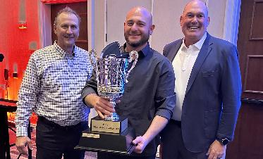
PTDC 2027
Gear Up for PTDC 2027!
A Whole New Venue!
This year’s event will be the first held at The Motor Enclave in Tampa
Real-World Course Challenges
Container delivery precision
Mailbox avoidance maneuvers
Truck parking mastery
Perfect alignment challenges
Storage Center Workers are BACK in 2027!
After the first Forklift Operating Championship in 2026, we’re excited to see our SCWs back at PTDC again!
Each year, PTDC’s challenges will test your skills in several different ways. Do you have what it takes to be named PTDC Champion?
Your Path to the Championship
Step 1: Local Qualifying Events
October 24, 2026
Compete at your regional location
Step 2: Finalists Announced
December 2026
Will you make the cut?
Step 3: Championship Tournament
April 3, 2027 – Tampa, Florida
The best of the best compete for the title

Slide 4


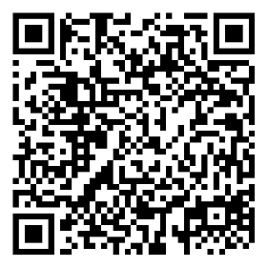
Q3 VIP Nominations Are Open Now!
It is that time again to recognize excellence and nominate an associate for the quarterly VIP Summit Award!
The Quarterly VIP Nomination flow will remain open through Friday, October 19, and all associates are encouraged to nominate peers for the Q3 VIP Summit Award.
Nominate a VIP Today!
When: Today through Friday, October 17
Where: Submit via Blue Door
Who: Any associate can nominate a deserving peer
Make Your Nomination Shine
The best nominations tell a great story! Be specific about how your nominee has demonstrated our values and made an impact.
Scan the QR Code included to submit your VIP Nomination!

Slide 5
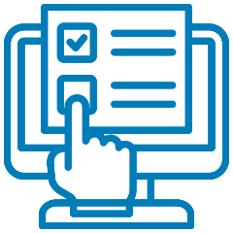
Field Ops Associate Survey
All field ops associates that were hired this year should have received a brief survey through UKG.
The survey will ask a few short questions about their experience at PODS, helping us gather valuable feedback from the field and identify opportunities to enhance the associate experience.
The survey should take less than 10 minutes to complete and participation is greatly appreciated. Your feedback is important and will help shape future improvements across our organization.

Slide 6
Winter Weather Tips
The winter season brings cold temperatures and severe weather conditions that create many hazards for individuals working in areas that experience these conditions. Even if you work indoors, winter weather still poses many hazards for you, such as driving into work in bad weather or walking through an icy parking lot to get to your building.
Winter Safety Driving Tips
Monitor weather for any incoming snow storms or icy conditions and plan your travel around those conditions.
Be a defensive driver. Stay clear of other drivers and maintain a safe distance in case you need to brake or turn to avoid an accident.
Do not drive in wintery conditions if possible. Eliminating driving eliminates your chances of being in an accident.
Slow down. Winter weather conditions necessitate reducing your speed. This will give you more time to react as well as help to avoid losing control of your vehicle.

Slide 7




Slip, Trip & Fall Prevention
Footwear
Always ensure footwear is in good condition with good lugs on soles.
Slippery Conditions
Remove trip hazards before snow or ice conditions are present. This eliminates someone tripping over a buried object after the snow or ice hits.
Shovel and salt parking lots and walkways prior to work beginning in that area. Prep walkways before workers get on-site in the morning.
Take your time when walking across slippery surfaces. Taking smaller steps lessens your chances of losing your balance.
Have the proper footwear on for the weather. Wear shoes with solid tread on the soles.

Slide 8


PODZILLA Safety Reminders
Keep these in mind next
time you operate a PODZILLA!
Request customers and others maintain 25’ clearance from the operating area
Always follow the
Property Damage
Prevention Policy
When backing the truck under PODZILLA, try to position for a straight back and back slowly to avoid motor mount impact into the cab protection device
When in doubt of clearance,
stop, settle the PODZILLA (lower the container to the ground so there isn't a suspended load), then go over and look at the overhead obstruction
When operating near wires, ensure you have 15’ of clearance and remember that wires droop more in high heat
When doing a container flip, ensure you have adequate
room. If you do not, contact your manager for
direction on how and where to complete the container flip safely

Slide 9
Drivers
October 2026

Slide 10



2026 Clean Inspection Bonuses
CONGRATULATIONS
To Our August
Clean Inspection Bonus Winners!
LEVEL 1 ($100)
LEVEL 2 ($50)
LEVEL 3 ($50)
Roger Bell
Miles Kinney
Timothy Lewis
John Lyons
Darren Moore
Rodney Roberts
Anthony Scoblick
Christopher Schuss
Carkis Turcios
Marisa Marks
Cheryl Murray
Marcelo Ruiz
Felipe Silva
Raymond Comas
Angel Garcia
Craig Walker
The PODS Safety team is awarding spot bonuses for each clean inspection by state or federal DOT officers!

Slide 11
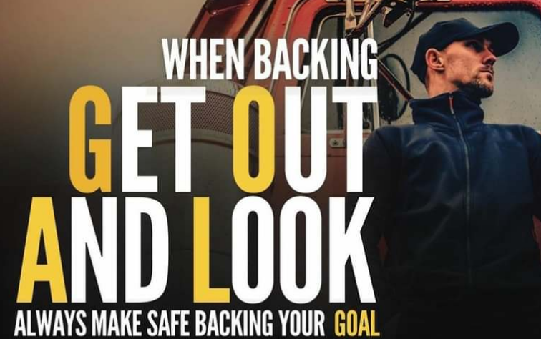
Safe Backing - Remember GOAL
Always stop the vehicle/equipment and Get Out And Look (GOAL) whenever you're backing up, operating in tight spaces, or unsure if there's enough clearance.

Slide 12

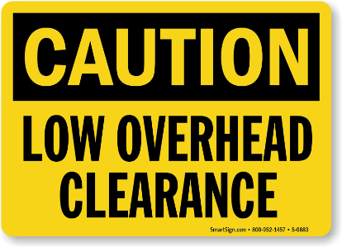

Watch for Overhead Hazards
As a driver, it is critical to be aware of overhead hazards.
Remember these crucial tips when faced with low bridges, underpasses, or other hazards:
Know your vehicle’s clearance height
Look ahead for risk
Slow down before you reach a potential overhead hazard
If you are approaching a low bridge, underpass, or narrow road, make sure that you slow down, turn on your hazard lights, and be aware of signs indicating clearance height.

Slide 13
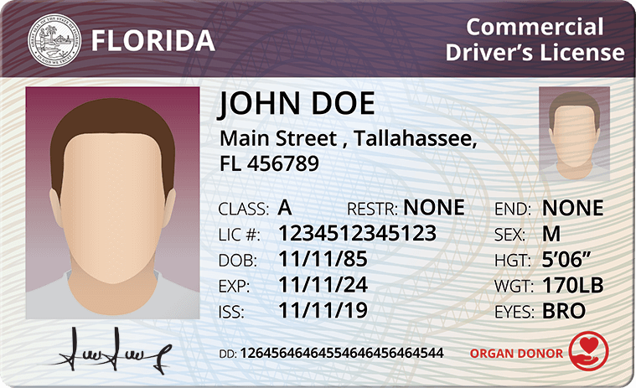
All Drivers MUST Obtain CDL License by December 31
All PODS non-CDL drivers are required to obtain a Commercial Driver’s License (CDL) by the end of the year.
How PODS Helps
PODS will cover Class B CDL training costs up to $3,650 per driver
Rate increase to CDL rate will be applied upon completion and verification of the driver’s license
Please contact your market manager with any further questions.

Slide 14


Frustrated? Your Air Horn Won’t Help
As a reminder, horn is primarily a safety device, and its misuse can contribute to road rage and unsafe driving conditions. The horn is intended to be used only while your vehicle is moving and when you need to warn other road users of your presence.
In most states, using your horn aggressively or to express frustration is not permitted.

Slide 15

Stopping On Interstate Warning
Stopping or parking on the shoulder of an interstate may seem convenient, but it is one of the most dangerous places a CMV driver can stop.
Traffic is moving at highway speeds, and distracted, fatigued, or impaired motorists can drift onto the shoulder with little warning.
PODS Policy
Unless it is a true emergency, drivers must avoid stopping/parking on interstate shoulders and instead plan ahead to use designated rest areas, truck stops, or other approved locations.
Making the extra effort to find a safe parking location protects you, your vehicle, and everyone sharing the road.

