Slide 1
September Huddle
2026

Slide 2
All Associates
September 2026

Slide 3


Continuous Improvement Corner
SEEING THE DEFECTS AROUND US
Continuous Improvement starts with noticing when something doesn’t happen the way it should. We call that a defect.
A defect could be…
A missed ETA
Incorrect order information
Equipment that isn’t ready
An avoidable extra trip
Unsafe conditions
Talk about it!
What are some defects you regularly encounter?
Are there things we have become so accustomed to working around that we now consider them “normal”?
Which of those defects seem to happen repeatedly?
How could we start keeping track of how often they occur?

Slide 4


Continuous Improvement Corner
THIS MONTH’S CI CHALLENGE
When you encounter something that doesn’t happen the way it should…
Notice it
Name it
Quantify it
Talk about it
The more clearly we can see our defects, the better we can identify the problems that are worth solving!

Slide 5
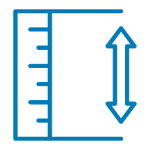
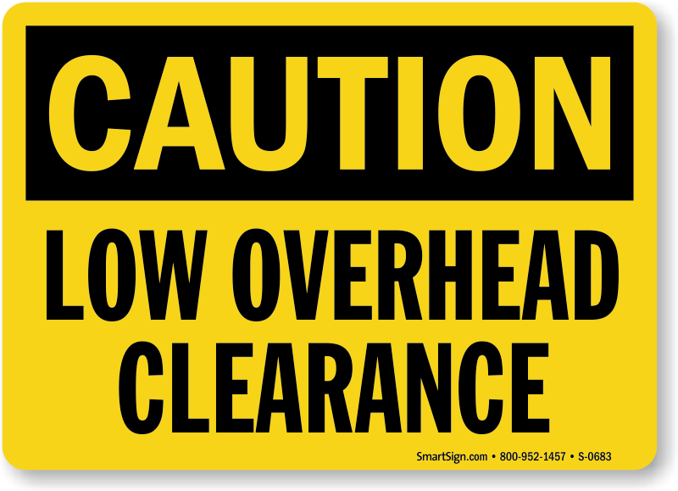
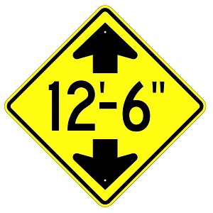
Watch for Overhead Hazards
As a driver, it is critical to be aware of overhead hazards.
Remember these crucial tips when faced with low bridges, underpasses, or other hazards:
Know your vehicle’s clearance height
Look ahead for risk
Slow down before you reach a potential overhead hazard
If you are approaching a low bridge, underpass, or narrow road, make sure that you slow down, turn on your hazard lights, and be aware of signs indicating clearance height.

Slide 6


PODZILLA Safety Reminders
Keep these in mind next
time you operate a PODZILLA!
Request customers and others maintain 25’ clearance from the operating area
Always follow the
Property Damage
Prevention Policy
When backing the truck under PODZILLA, try to position for a straight back and back slowly to avoid motor mount impact into the cab protection device
When in doubt of clearance,
stop, settle the PODZILLA (lower the container to the ground so there isn't a suspended load), then go over and look at the overhead obstruction
When operating near wires, ensure you have 15’ of clearance and remember that wires droop more in high heat
When doing a container flip, ensure you have adequate
room. If you do not, contact your manager for
direction on how and where to complete the container flip safely

Slide 7
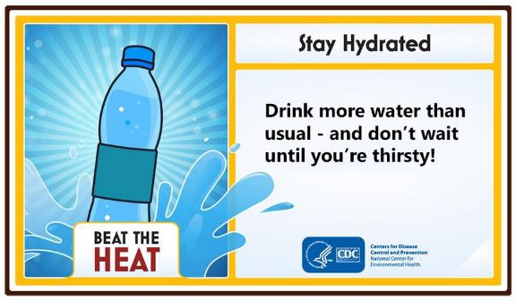
Don’t Forget Your Water This Summer!
The summer heat is here — remember to stay hydrated!

Slide 8
Drivers
September 2026

Slide 9



2026 Clean Inspection Bonuses
CONGRATULATIONS
To Our July
Clean Inspection Bonus Winners!
LEVEL 1 ($100)
LEVEL 2 ($50)
LEVEL 3 ($50)
Jonathan Eardley
Micheala Edwards
Joseph Graham
Eugene Hahn
James Hammers
Cheyenne Haynes
Terrance Jones
James Lamb
Darren Naaktgeboren
Cesar Quijas Aranda
Michael Robinson
Felipe Silva
Isamar Castro
Ramon Escalante
Rowland Holden
Sabino Roman Martin
Chance Ackerson
Jimmy Ramento
Axel Rivas
Christopher Schuss
Spencer Vickers
The PODS Safety team is awarding spot bonuses for each clean inspection by state or federal DOT officers!

Slide 10
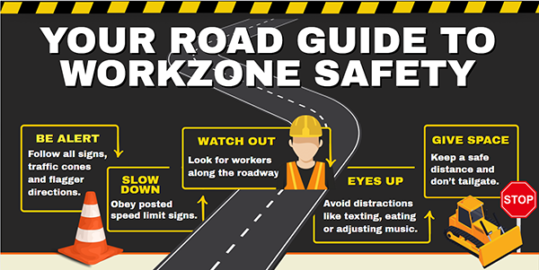
Construction Zone Speed Limits
Stay aware of speed limit changes in construction zones!
Watch for temporary signs indicating a reduction in the speed limit through construction zones.
In addition to the danger that speeding in these areas creates, your speed may be noticed by Motive or Law Enforcement—potentially causing a direct hit to your Safety Score, your wallet, and your driver’s license!

Slide 11




Distracted Driving
DISTRACTED DRIVING
What to look for
Did I take my eyes from the road for an extended time, or multiple times over a short time?
Tips to avoid distracted driving:
As a general rule, if you cannot devote your full attention to driving because of some other activity, it’s a distraction.
Snack smart! Eat meals or snacks before or after your trip – not while driving.
Store loose gear, possessions, and other distractions that could roll around in the truck, so you do not feel tempted to reach for them on the floor or the seat.
Make adjustments before you get underway. This includes adjusting your seat, mirrors and climate controls before hitting the road.
If another activity demands your attention, pull off the road and stop your vehicle in a safe place instead of trying to attempt it while driving
WHAT NOT TO DO
VISUAL Looking at something other than the road | AUDITORY Using devices that keep you from hearing the road | Manual Manipulating something other than the steering wheel | Cognitive Thinking about something other than driving
THE “WHY”
Each day, approximately 9 people are killed and 1,000 people are injured in crashes reported to involve a distracted driver. A recent study found that 71% of large-truck crashes occurred when the truck driver was doing something besides driving the truck.

