Slide 1
PODS Fuel Management Program
Fueling Standard Operating Procedure
Effective 8/10/2026

Slide 2
Agenda
Purpose & Scope
WEX CONNECT App Implementation
End-of-Shift Fueling Standard
Zero-Tolerance Compliance & Weekly Audits
Fuel Receipt Verification
Driver PIN Controls
Roles & Responsibilities
Exceptions, Records & Compliance

Slide 3
Policy Fundamentals
Establishing the WEX fueling program for the field.

Slide 4
1. Purpose & Scope
Purpose
Reduce fuel costs
Improve accountability and operational efficiency
Strengthen internal controls
Ensure consistent compliance across all markets
Scope
All PODS Market Managers
All employees authorized to operate PODS trucks and forklifts
All company-owned or leased vehicles utilizing the WEX fuel program

Slide 5
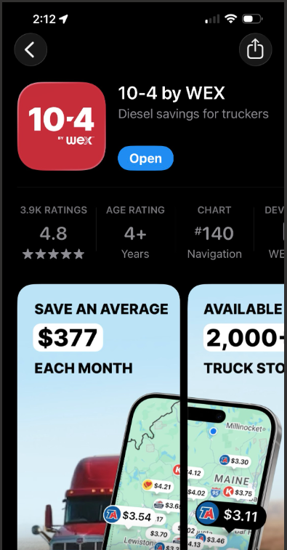
2. WEX CONNECT App Implementation
Install & Maintain
Each Market Manager
installs and maintains the
WEX mobile application.
Identify 2–3 Locations
Select approved fueling
locations offering the lowest
prices, conveniently near the
warehouse.
Review Periodically
Approved locations are
reviewed and updated as
pricing or operational needs
change.
Communicate to Drivers
Market Managers ensure
every driver knows approved
locations before operating
company vehicles.

Slide 6
3. End-of-Shift Fueling Standard
Step 1 — Fuel at Approved Location
Drivers fuel company trucks at a
designated approved location at the
end of each shift. They will have 2-3
locations so direction of arrival
should not be an issue.
Step 2 — Return Ready for Next Shift
Vehicles are returned with sufficient
fuel to support the next scheduled
shift, minimizing delays.
Step 3 — Report Exceptions Immediately
Anything preventing end-of-shift
fueling is reported to the Market
Manager immediately and
documented.

Slide 7
4. Zero-Tolerance Compliance
Mandatory Adherence
Compliance with the approved fueling program is required for all employees operating company vehicles.
Documented management approval is the only path to an exception.
Policy Violations
Fuel purchases at unapproved locations without documented approval
Failure to follow established fueling procedures
Result: immediate review, and possible corrective action up to loss of driving privileges.

Slide 8
Procedures & Accountability
Audits, records, roles, and compliance

Slide 9
5. Weekly Compliance Audits
WEX Reporting Review — conducted weekly by every Market Manager
Verify fueling occurred at approved locations
Monitor fuel spending and purchasing trends
Identify unauthorized transactions or exceptions
Confirm compliance with company fueling standards
Keep records secure and organized
Be prepared for audits with IA and TM
Exception Resolution
Discrepancies found in the audit are investigated promptly, documented, and resolved.
Note: WEX is building an automated weekly report to support this review.

Slide 10
6. Fuel Receipt Verification
Driver Responsibility
Drivers submit all fuel receipts to their Market Manager at the end of each workday.
Location Match
Manager verifies fuel purchases were made at approved fueling locations.
Amount & Gallons Check
Purchase amounts align with WEX records; gallons are reasonable for the vehicle or equipment fueled.
Record Retention
Fuel receipts and supporting documentation are retained per company record retention requirements.

Slide 11
7. Driver PIN Controls
PIN Assignment
Every authorized driver is assigned a unique WEX driver PIN. PIN sharing is strictly prohibited.
(PINS will be coming in the next few weeks.)
Daily Monitoring
A recurring audit verifies each driver PIN is used no more than once per day, unless a documented exception exists.
Periodic Audits
Market Managers validate PINs belong only to active drivers and remove inactive or unauthorized PINs.

Slide 12
Roles & Responsibilities
Drivers
Fuel only at approved fueling locations
Fuel company vehicles at the end of each shift
Submit all fuel receipts daily
Protect and use only their assigned WEX PIN
Immediately report fueling issues or exceptions
Enter Mileage on pump screens for Vehicles and Hours for Lifts and PODzillas.
Market Managers
Maintain 2–3 approved fueling locations via the WEX app
Route the fueling stop at the end of the shift
Communicate approved locations to all drivers
Verify daily fuel receipts and review weekly WEX reports
Investigate exceptions and conduct PIN audits

Slide 13
Operational Exceptions
1. Communicate
Communicated to the Market
Manager as soon as practical.
2. Document
Documented in writing, explaining the
reason for the exception.
3. Approve
Reviewed and approved by
management.

Slide 14
Records & Compliance
Records Maintained
Daily fuel receipts
Weekly WEX compliance reports
Driver PIN audit reports
Fueling exception documentation
Corrective action documentation, when applicable
Non-Compliance Consequences
Review of fueling activity
Coaching or retraining
Corrective or disciplinary action per PODS policy
Suspension or revocation of driving privileges when appropriate

Slide 15
Addition to the policy
Specific fuel purchases allowed - Diesel for trucks and 87 for PodZillas, and DEF, Midgrade, Premium, and Off Road Diesel Prohibited.
Fuel Card are not to be taken home – All cards remain with the truck.
Accurate odometer readings entered for trucks, and PodZilla hours
Separate transactions would need to occur for the truck and PodZilla, so PINs would be used twice, but within the same time frame.
Process for lost or damaged fuel cards remains the same. See program on Intranet
Information on where to buy the Fuel Card Key Chains located on Intranet
Information on where the WEX reports are going to be maintained or filed here - F:\Corp Ops\Fuel Program

Slide 16
Thank You

