Slide 1
August Huddle
2026

Slide 2
All Associates
August 2026

Slide 3


Beat the Heat!
What should you do to stay safe and healthy in the summer heat?
    Be sure to have enough fluids on hand and drink regularly throughout the day. If you wait until you are thirsty, you may already be dehydrated.
Use the hydration station and/or water fountains during operational hours.
Avoid caffeinated drinks during the day and foods rich with sugar. When off duty, minimize alcoholic drinks as they can contribute to dehydration.
Take advantage of time in the shade or in air-conditioned areas to give your body a break from the heat.
Be sure to get enough rest.
Monitor yourself and co-workers and notify a manager when you need a break from the heat.
Wear loose-fitting clothes.

Slide 4
Beat the Heat!
What are the risks to those in cities?
Without time to adjust to the heat, you will feel more physical and mental fatigue.
Cities can be up to 10 degrees Fahrenheit (6 degrees Celsius)
hotter, since concrete and asphalt hold and radiate heat.
Higher humidity adds to the heat load and makes it harder
for sweat to cool the body.
What are the risks to those working in the warehouse?
Poor air flow. Keep fans running and bay doors open for
cross ventilation.
Be sure to take frequent breaks and communicate with management
if you need anything (longer breaks, more items to hydrate with, etc.)

Slide 5
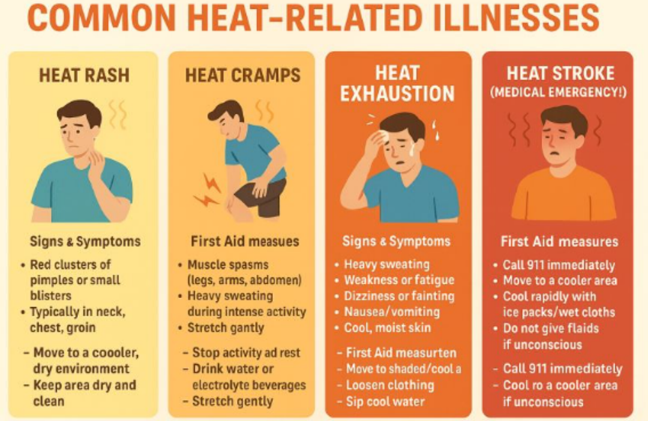
Beat the Heat!

Slide 6
WRT Not Locked Properly – Driver Responsibilities
Drivers
Upon arriving at a location, inspect the WRT container’s latch and lock to ensure that it is secured appropriately
If the container is unlocked/improperly secured, attempt to notify the customer on-site or by phone
If you are unable to solve the issue on-site, document the following items with photos in Cheetah:
  Photos of unsecured door with latch and lock visible
  Photos of container contents from container door, with the container number visible
Use a cam buckle strap to secure door from latch to the base of the container
Transport the unsecured container back to the storage center and notify your Storage Center Worker of the issue

Slide 7
WRT Not Locked Properly – SCW Responsibilities
SCW
Unload container and place it in a safe workspace
Remove existing lock with a cutting tool, slide latch to properly secure the container, and replace the previous lock with a new combination lock
  Set the combination lock code with any random combination
Place the newly-secured container in the Storage Center/POD Hunter
Communicate the issue to your market manager, and the steps you’ve taken to solve the issue
  Provide your market manager with the container number, the customer ID number, and the new lock’s combination number

Slide 8
Drivers
August 2026

Slide 9



2026 Clean Inspection Bonuses
CONGRATULATIONS
To Our June
Clean Inspection Bonus Winners!
LEVEL 1 ($100)
LEVEL 2 ($50)
LEVEL 3 ($50)
Benjamin Andrade
Joshua Boulanger
David Cunningham
Moises Duron
Alex Kuria
James Moore
Vincent Rivera
Sidney Rodrigue
Jaquon Wilkerson
Matthew Narsiff
Cheryl Murray
Kenneth Smith
Lynette Thompson
Jermaine Washington
Cheyenne Haynes
Miles Kinney
Ka Lee
Andre Marshall
Corbin Swindle
Timothy Taylor
Stephen Wallace
Jaiquawn Williams
The PODS Safety team is awarding spot bonuses for each clean inspection by state or federal DOT officers!

Slide 10
Backing – Part II
On Road
Safety
Before Backing, Drivers Should:
Stop
Bring the vehicle to a complete stop
Survey
Assess:
Pedestrian traffic
Children and pets
Customer activity
Other vehicles
Fixed objects
Utility structures
Trees and landscaping
Overhead obstructions
Ground conditions
Driveway and pavement integrity
Surface slopes and grades
If a hazard cannot be fixed, ask your manager for help.
Avoid backing when you can. If you must back, go only as far as the job requires. First, complete a Pre-Backing Hazard Assessment and
note any hazards you may face.

Slide 11

Backing – Part I

Slide 12


Brake Safety Campaigns
CVSA’s Operation Airbrake program will hold two annual brake safety campaigns throughout 2026.
The next Brake Safety Week is scheduled for Aug. 23-29, 2026
There will also be one unannounced one-day brake safety enforcement initiative, which may take place at any time
During both the announced and unannounced brake safety enforcement campaigns, commercial motor vehicle inspectors conduct brake system inspections on large trucks and buses throughout North America to identify brake-system violations.

Slide 13
Driver Ancillary Fulfillment Process
Before Leaving the Yard
1. Review Driver Log & Route
Pick up driver log from Market Manager
Review all jobs for ancillary requirements
Check driver notes for locks and blankets needed
Escalate any unclear requests to Market Manager before departure
2. Verify Truck Inventory
Minimum 10 locks on every truck at start of shift
Confirm inventory meets route requirements
Ensure adequate blankets are available if required
Report inventory shortages before leaving
Onsite Deliver & Additional Sales
1. Deliver Purchased Ancillary Items
Open the Cheetah app for the current job
Confirm items and quantities purchased
Load requested items into the container
Fold and place blankets neatly
Document fulfillment with photos in Cheetah
2. If Customer Wants Additional Items:
Add requested locks/blankets through the Driver Report in Cheetah
Enter quantity and select Done
This automatically triggers customer billing
No Market Manager action required

Slide 14

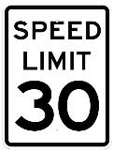
School’s Out, Stay Alert!
School’s Out for Summer
And that means more kids are out, especially in neighborhoods.
Stay alert and expect the unexpected.
Look for kids playing near the street and scan between parked cars and other objects for signs that children are at play in the area
Make eye contact with children who are about to cross the street and watch for their next step
Always obey speed limit signs and be alert to changing traffic patterns

