Slide 1
July Huddle
2026

Slide 2
All Associates
July 2026

Slide 3

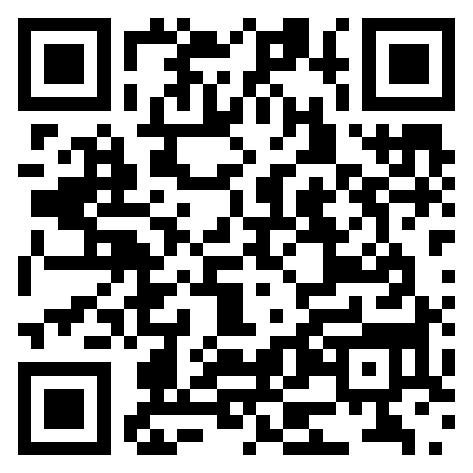
Celebrating National Logistics Day
National Logistics Day is celebrated annually to recognize and thank the logistics associates who help keep our operations at PODS moving!
At PODS, Logistics handles:
The routing, scheduling, and efficiency of PODS’ long-distance operations
The management of vendor fleet optimization, asset utilization, and demand planning
Container inventory, availability, and forecasting
Scan the QR code to see a special National Logistics Day message from COO James Shively

Slide 4
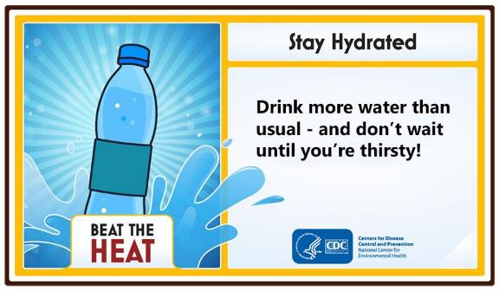
Don’t Forget Your Water This Summer!
The summer heat is here — remember to stay hydrated!

Slide 5
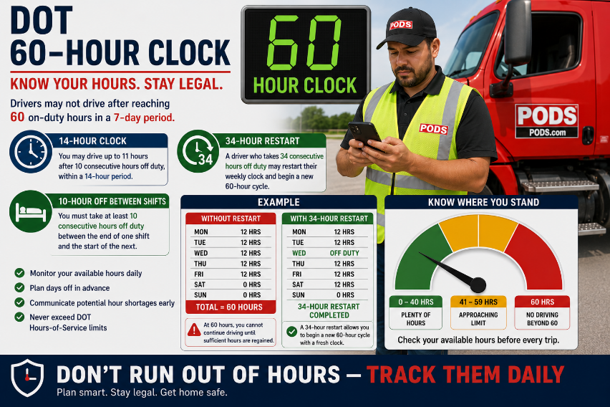
DOT Hours

Slide 6
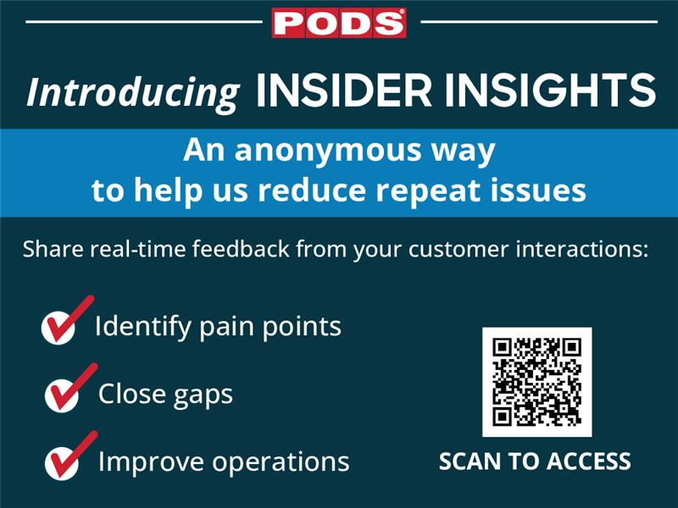

Slide 7
Drivers
July 2026

Slide 8



2026 Clean Inspection Bonuses
CONGRATULATIONS
To Our May
Clean Inspection Bonus Winners!
LEVEL 1 ($100)
LEVEL 2 ($50)
LEVEL 3 ($50)
Thomas Ammer
Roy Baldinger
Rebecca Baldus
Shawn Bielinski
Clark Bowman
Cory Bridges
Moises Duron
Eric Gettleman
Robinn Hathaway
Chazz Lewis
Michael Linabury
Steve Lynch
Martin Madrigal Garcia
Larry Maginniss
Francisco Marquez
James Moore
Edward Reid
Aleksandr Sribnyi
Clayton Williams III
Richard Blau
Trevor Kazen
Jerry Pilcher
Joel Allison
Michael Dillard
Blaine Duncan
Forrest Durfee
Michael Gamble
Jaime Jones
Christopher Kotchkoski
James Lamb
David Lucas
Sabino Martin
Brian Torrance
Keith White
The PODS Safety team is awarding spot bonuses for each clean inspection by state or federal DOT officers!

Slide 9
Be Safe Around Independence Day
Tens of millions of Americans travel around Independence Day, so it’s important to be vigilant and practice defensive driving techniques, especially with busier roadways anticipated.
Be Aware of Your Surroundings
Look Ahead
Look Around
Leave Room
Communicate

Slide 10
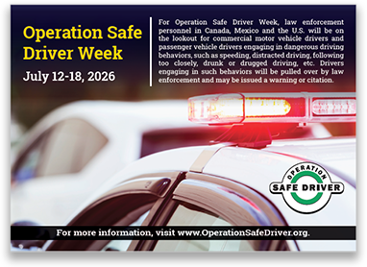
Operation Safe Driver Week
Operation Safe Driver Week is scheduled for July 12-18, 2026.
During Operation Safe Driver Week, law enforcement agencies use educational and traffic enforcement strategies to target unsafe driving behaviors performed by passenger vehicle drivers and commercial motor vehicle drivers
On Road
Safety

Slide 11
Backing – Part I
Backing should be considered the last available option after all reasonable alternatives have been evaluated.
Drivers should:
Avoid backing whenever possible. If you must back, back only far enough to get out of the roadway.
Use pull-through parking when available
Position vehicles to enable forward movement upon departure.
Conduct a backing hazard assessment before reversing
Operate at the slowest reasonable speed while backing
Stop immediately if uncertainty exists regarding clearance or hazards.
On Road
Safety

Slide 12
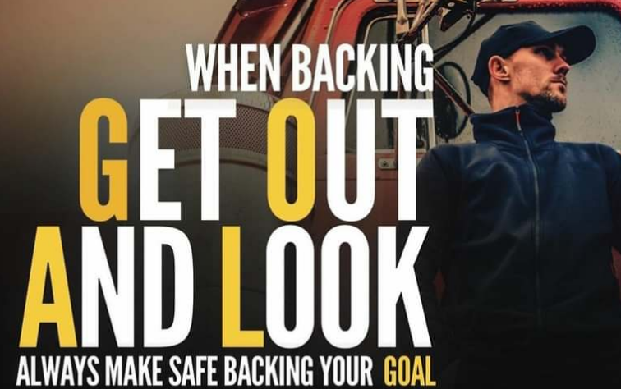
Backing – Part I
If you must back in…. remember to Get Out And Look
GOAL
Get Out And Look before backing when:
The backing path has not been recently verified.
Conditions have changed.
Sightlines are restricted.
Clearance is uncertain.
Pedestrians may be present.
On Road
Safety

Slide 13

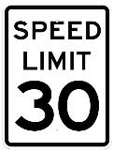
School’s Out, Stay Alert!
School’s Out for Summer
And that means more kids are out, especially in neighborhoods.
Stay alert and expect the unexpected.
Look for kids playing near the street and scan between parked cars and other objects for signs that children are at play in the area
Make eye contact with children who are about to cross the street and watch for their next step
Always obey speed limit signs and be alert to changing traffic patterns

Slide 14

Help Prevent Long Idling
Gas prices are rising — we need your help to reduce long idles!
Less idling means:
    Lower fuel costs
    Less wear on vehicles
    More efficient operations
This is a team effort — every minute counts!
Small changes make a big impact across the fleet.
Turn off the engine if you’re going to be parked for
more than 3 minutes.

Slide 15
Storage Center Workers
July 2026

Slide 16
Steel Roof Certification Program is LIVE!
Effective immediately, only associates who have successfully completed all three components of the Steel Roof Certification Program are authorized to perform repairs requiring the removal or replacement of a steel roof.
To be considered certified, an associate must have completed all of the following requirements:
The required eLearning course
The hands-on practical evaluation
Documentation uploaded and recorded in UKG
Associates who need to be enrolled in the Steel Roof Certification Program should contact Sam Fresquez to begin the certification process, or have their market manager do so for them.

