Slide 1
June Huddle
2026

Slide 2
All Associates
June 2026

Slide 3

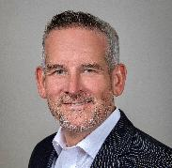
A Message from COO James Shively
As we enter our peak season together as one unified operations team, I want to recognize the hard work, preparation, and commitment to our customers that associates across the enterprise demonstrate every day.
Peak season always brings challenges – long days, unexpected issues, and moments that test our ability to adapt and respond quickly. But it also brings opportunity, and the foundation I’ve seen across the organization gives me great confidence in the season ahead.
In my first few weeks at PODS, one of the things I noticed was the passion our associates have for both the work they do and the experience they provide for our customers. I see teams focused on continuous improvement, strong execution, safe operations, and doing things the right way. These qualities will not only help us succeed this peak season but also strengthen our business for the future.
As activity increases, so does risk, and safety must remain at the center of everything we do. While results matter, no outcome is worth compromising the safety of our associates, our customers, or communities. The most important measure of success to me is that every associate goes home each night in the same condition they arrived.
I’m excited about where we are headed. We have a lot of work ahead of us, and we will continue learning and improving along the way, but I believe the preparation leading into this season has positioned us well.
Thank you for everything you do each day. Let’s have a safe, strong, and successful peak season

Slide 4
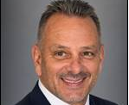
Congratulations, Charlie Villemaire
Promoted to Hydraulic Lift Systems Manager
Now overseeing fleet planning and maintenance for both PODZILLAs and forklifts
Serving as PODS’ subject matter expert for hydraulic delivery systems, process improvements, service quality, and cost management
Please continue to include Brannon Hufstetler on all repair requests during the transition

Slide 5


Congratulations VIP Winners!
Congratulations
Q1 VIP Winners!
Bryan Davidson – Mgr II, Ops Optimization
Tyler Beckwith – Driver I - Lead (Central)
Patrick Gilmore – Territory Manager II (West)
Sean King – Market Manager I (Canada)
Floyd Knott – Driver I - Lead (West)
Josh Koch – Market Manager I (Central)
Dexter Lopez – Driver - Class B (Southeast)
Jim Mattern – Market Manager I (Northeast)
Jonathan Rivera – Driver I – Lead (Northeast)
Luis Sanchez – Driver - Class B (Southeast)
The associates selected as VIP Summit Winners are seen by senior leadership as true embodiments of our values – we work as a team, we care, and we find a way.

Slide 6

Don’t Forget Your Water This Summer!
The summer heat is here — remember to stay hydrated!

Slide 7
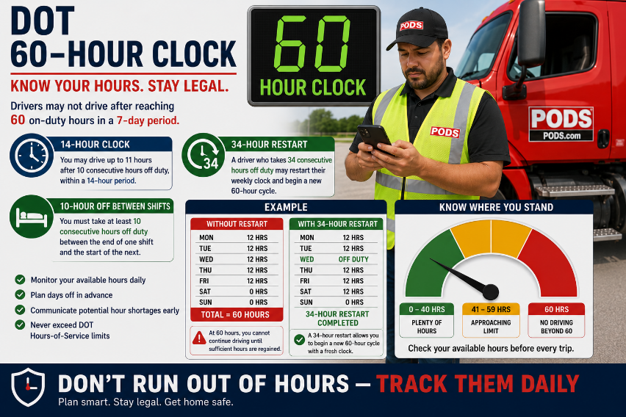
DOT Hours

Slide 8
Thank You for Driving SAFELY!
Drivers, thank you for your commitment to safety! The associates below have driven 1,000+ miles with Motive score of 100 with zero “events” over the past 30 days, as of June 3.
Central
Rahmat Ahmadi
Rebecca Baldus
Joel Behm
Warren Bostic
Aaron Carter
Nicholas Coles
Charles Connolly
Scott Cooper
Gerson Cordero Martinez
James Cunniffe
David Duffee
Larry Dunklin
Wesley Dukes
Moises Martinez Duron
Windfield Ellis
Roger Funk
Trenayne Gordon
Dustin Goldsberry
Xiao Han
Jon Jaschen
Tyler Johnson
Ryan Michaelson
Jesus Mendoza
Jeffrey Mouthey
Weshton Oleszczuk
Pedro Olvera
Vincent Pallotta
Daniel Penman
Dennis Plass
Santiago Reyna
Joshua Rice
Jason Robertson
Sidney Rodrigue
Joseph Scofield
Tate Seacrest
Ramsey Smith
Christopher Snow
Bradley Sparks
Jasmine Stevenson
Mark Stowe
Cecil Thompson
Nicholas Traylor
David Turner
Jeff Ullrich
Robert Varn
Mike Wager
Ernest Wilds
James Whitfield
Joe Wishert
Joshua Winchell
Albert Woyna
Hai Do

Slide 9
Thank You for Driving SAFELY!
Drivers, thank you for your commitment to safety! The associates below have driven 1,000+ miles with Motive score of 100 with zero “events” over the past 30 days, as of June 3.
Northeast
Floyd Adams
Eric Barrett
Harrison Barnett
Michael Booker
Johnny Broaden
Raymond Comas
David Dutton
Brian Faust
Anthony Funkhouser
Melido Garcia
Brian Garner
Courtney Gillespie
Antoine Gulley
Jennifer Gunter
Calmon Heller
Dean Herrmann
Robert Jackson
Michael Linabury
Robert McClinton
Bradley O'Brien
Kenton Petit May
Leonardo Parafita
Stephen Quistgaard
Edward Reid
Raymond Ridge
Axel Rivas Barrera
Angel Sanchez
Christopher Santos
Travis Schermerhorn
Christopher Schuss
Marcelo Silva
Nelson Vazquez
William Wilson
Hugh Wright
Thomas Young
Christopher Zona

Slide 10
Thank You for Driving SAFELY!
Drivers, thank you for your commitment to safety! The associates below have driven 1,000+ miles with Motive score of 100 with zero “events” over the past 30 days, as of June 3.
Southeast
Juan Abreu
Justin Andrews
Pedro Alicea
Stephana Bellamy
Joshua Byrd
Thomas Chontofalsky
Jason Colon
Julio Cruz
Jarvis Devereaux
Dakotah Do
Michael Dillard
Roy Driggers
Jalen Epps
Anderson Feliz
David Jeff
Nicholas Garrett
Isaiah Gore
Taj Glover
Trent Gordin
Bobby Hatchell
Christopher Irons
Travis James
Alex Kurja
B Maldonado
Robert Meyer
Kenterris Murray
Erica Newsom
Joe Nicholson
Jose Perez
Anibal Quinones
Daniel Ruiz
Deandre Sabb
Peter Slavick
Raul Cristancho Soto
Emmanuel Santiago
William Sears
Thomas Tallent
Lloyd Turner
Keith White
Billy Williams
Samuel Whittington

Slide 11
Thank You for Driving SAFELY!
Drivers, thank you for your commitment to safety! The associates below have driven 1,000+ miles with Motive score of 100 with zero “events” over the past 30 days, as of June 3.
Canada
West
Paul Antoine Gagnier
James Kingsbury
Christopher Joiner
Christopher Aines
Jose Arteaga Gonzalez
Dana Chai
Rufino Cervantes
Richard Deza
Cesar De La Mora Arciniega
Raymond Jones
Austin Kearns
Steven Lee
Yolanda Richielieu
David Ortega
Kevinte Thompson
Tiona Thompson
Aron Wortham
Oscar Hernandez
James Hammers
Elias Juarez

Slide 12
Drivers
June 2026

Slide 13



2026 Clean Inspection Bonuses
CONGRATULATIONS
To Our April
Clean Inspection Bonus Winners!
LEVEL 1 ($100)
LEVEL 2 ($50)
LEVEL 3 ($50)
Kenneth Allen
Ramon Escalante
Calmon Heller
Emmanuel Igwe
James Moore
Edward Reid
Andre Wood Jr.
Edward Brooks
Martin Garcia
Gregory Lange
Miles Kinney
Andres Ramirez Cordoba
Manuel Torres
Eugene Welsch
Inez Jones
Phillip Banker
David Bramley
David Cintron
Carlos Ayon-Arredondo
Kenneth Justus
Ricardo Karoba Garces
Dangelo Miller
James Moore
Sidney Roberts-Martin
Travis Schermerhorn
Corbin Swindle
Albert Torelli
Nelson Vazquez
The PODS Safety team is awarding spot bonuses for each clean inspection by state or federal DOT officers!

Slide 14
See What Our Customers are Saying!
The comments below were left by PODS customers. Thank you for continuing to provide our customers with the BEST possible experience during their moves!
Lynette Thompson – Syracuse, NY
“Lynette was very professional, did a fantastic job, was friendly and easy to work with. She was very concerned and took great care and attention to my driveway and basketball hoop.”
Christopher Zona – Rochester, NY
I was totally satisfied with the complete process. I especially liked the driver (Chris) for his expertise in getting the pod in a good location and picking it up. He was a very nice person and easy to work with. And he was very efficient in doing what was necessary.
Darren Moore – Little Rock, AR
“Darren treated me with respect and kindness. He is extremely nice, knowledgeable, prompt, professional, kept me informed, and efficient. Darren exceeds customer expectations and ensured I was satisfied. Teach others to use Darren as the great role model in customer service. Darren has outstanding interpersonal relationship skills and customer relationship skills. He stayed in touch as frequently as appropriate. He is prompt, efficient, professional, kind, knowledgeable and overall awesome! Darren should be involved in training the other employees to be customer-oriented.”
Kevin Promnick – Edmonton, AB Canada
“I was happy with the whole experience. The size of the container was exactly what was needed. The delivery and pick up arrangements were accurate and in a timely manner. The container was clean, the overhead door worked well. In speaking with the staff and drivers, they were friendly and knowledgeable. Thank you PODS!”
Martin Madrigal Garcia, Steven Lee – Fresno, CA
The service was quick both for delivery as promised and for pick-up. The driver worked with me to find the best spot for the pod. My initial spot didn't work out due to an obstruction but we worked it out together as best we could.
Calvin Williams Jr. – Huntsville, AL
“The driver that delivered the container at the final location was outstanding and very cooperative. Calvin was really helpful and gave me confidence in using pods for our next move. Thank you!”
Jacob Laurie, Cierra Walden – Fayetteville, NC
“All of our drivers were exceptional. My only regret is I neglected to give Cierra a tip.”

Slide 15


School’s Out, Stay Alert!
School’s Out for Summer
And that means more kids are out, especially in neighborhoods.
Stay alert and expect the unexpected.
Look for kids playing near the street and scan between parked cars and other objects for signs that children are at play in the area
Make eye contact with children who are about to cross the street and watch for their next step
Always obey speed limit signs and be alert to changing traffic patterns

Slide 16

Help Prevent Long Idling
Gas prices are rising — we need your help to reduce long idles!
Less idling means:
    Lower fuel costs
    Less wear on vehicles
    More efficient operations
This is a team effort — every minute counts!
Small changes make a big impact across the fleet.
Turn off the engine if you’re going to be parked for
more than 3 minutes.

Slide 17
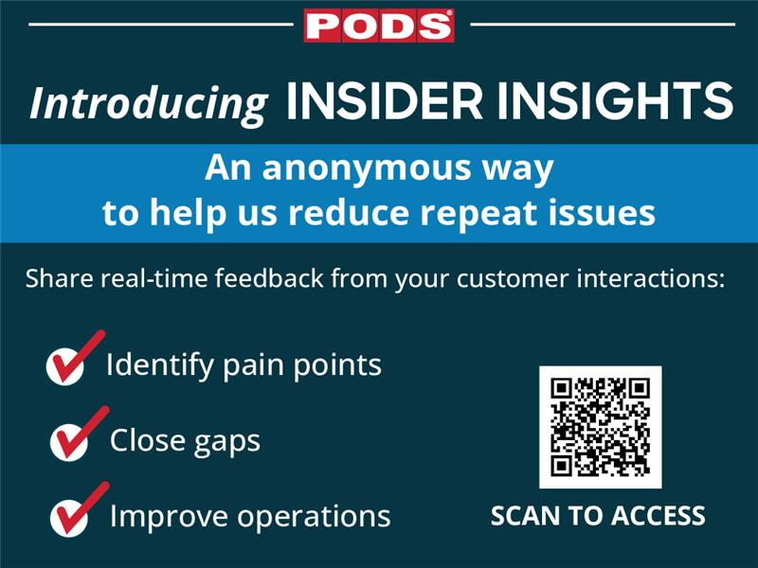

Slide 18
Storage Center Workers
June 2026

Slide 19
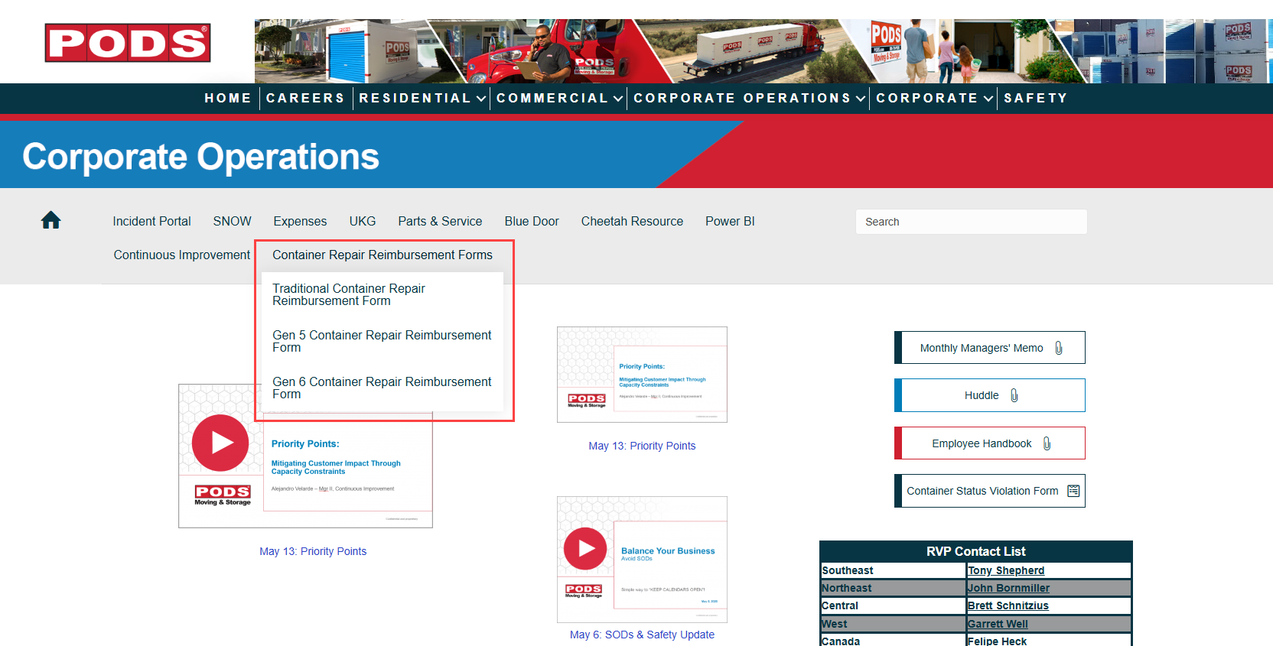
New Container Repair Reimbursement Forms
Container Repair Reimbursement Forms are now available on the Corp Ops intranet.
Effective immediately, discontinue the use of previous forms.
To access the forms, hover over the “Container Repair Reimbursement Forms” tab shown below and select the appropriate form type.
As a reminder, please do not save and reuse local copies of these forms. Instead, download the forms directly from the intranet to ensure you are using the most current version.

