Slide 1
May Huddle
2026

Slide 2
All Associates
May 2026

Slide 3

Pre-Trip Inspections
A pre/post-trip inspection helps identify potential mechanical issues or unsafe conditions and is critical in preventing accidents, injuries, and costly repairs. These DVIRs are REQUIRED.
Pre-Trip Inspections:
Reduce Accidents
A thorough pre-trip/post-trip inspection can reveal problems like faulty brakes, worn tires, or malfunctioning lights.
Prevent Breakdowns
Identifying issues early can prevent inconvenient and costly breakdowns on the road, saving time and money.
Protect Everyone
Commercial vehicles are large and powerful, and their malfunctions can have serious consequences for other drivers on the road.
Failure to conduct them can result in fines, penalties, an impact to your bonus, and even the suspension of your commercial driver's license.
If you are coded under 304 for part of your day and forklift certified,
you must also complete a forklift DVIR!

Slide 4

Mark Your Calendar: International Roadcheck
Get Ready for International Roadcheck: May 12-14
International Roadcheck is the largest targeted enforcement program on commercial motor vehicles in the world, with nearly 15 trucks or motorcoaches inspected, on average, every minute across North America during this 72-hour period.
During International Roadcheck 2025:
There were over 30,000 Level I, II, and III inspections conducted in the U.S.
Of the 56,178 total vehicle inspections conducted, 18.1% were placed out of service
This year’s focus is on Cargo Securement and ELD Tampering.
During inspections, officers will verify:
Proper tie-downs
Load stability and shifting risk
Loose components and dunnage
Accuracy of duty status logs
Signs of tampering/manipulation
Proper use of ELD and exemptions

Slide 5

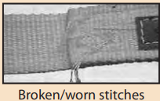
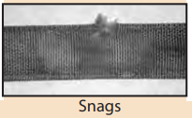
How to Inspect Tie Downs
Perform a visual inspection of the entire tie down to detect possible damage. Look for any of the types of conditions listed below.
The entire tie down must be inspected before each use. Remove from service if ANY of the following are detected:
Holes, tears, cuts, snags or embedded materials
Broken or worn stitches in the load bearing splices
Knots in any part of the webbing
Excessive abrasive wear or crushed webbing.
Distortion, excessive pitting, corrosion or other damage to buckles or end fitting(s)
Any conditions which cause doubt as to the strength of the tie down
EXAMPLES
Bad straps

Slide 6
Drivers
May 2026

Slide 7



2026 Clean Inspection Bonuses
CONGRATULATIONS
To Our March
Clean Inspection Bonus Winners!
LEVEL 1 ($100)
LEVEL 2 ($50)
LEVEL 3 ($50)
Michael Gibson
Willie Hammond
Vincent Holt
Leanid Klopat
James Lamb
Keith Linton
Moises Lopez
Moises Duron
Rowland Holden
Denise Reamore
Mark Alfano
Thomas Ammer
Cory Bridges
David Cintron
Anthony De Luco
Szymon Frackowiak
Emmanuel Igwe
Trevor Kazen
Floyd Knott
Matthew Martin
Jose Perez
Edward Perkins
The PODS Safety team is awarding spot bonuses for each clean inspection by state or federal DOT officers!

Slide 8
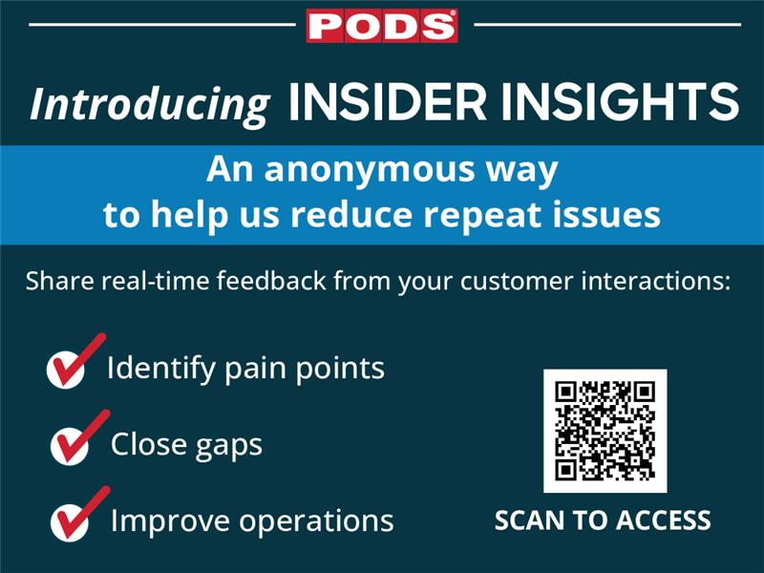

Slide 9
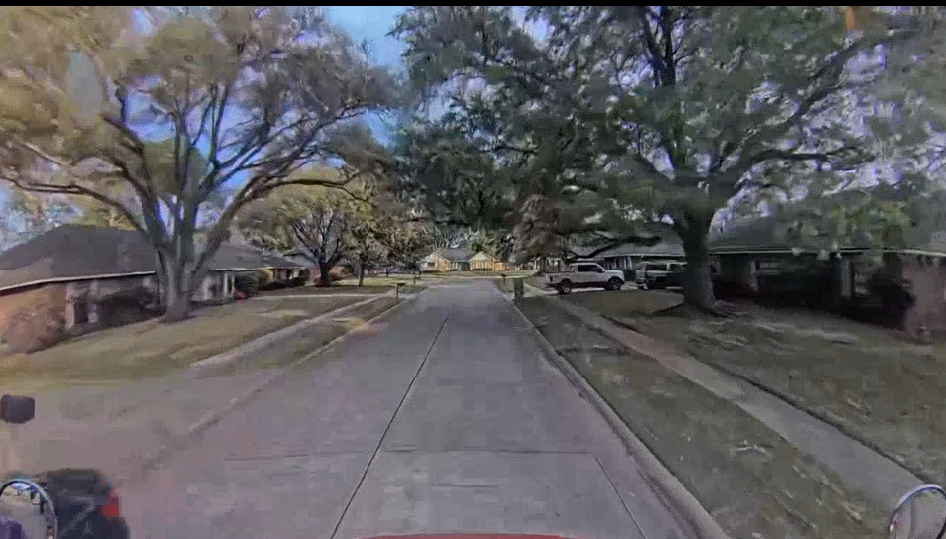
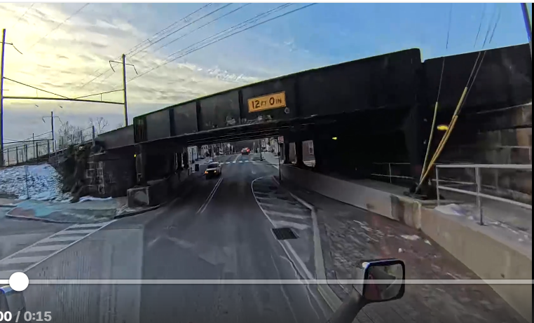
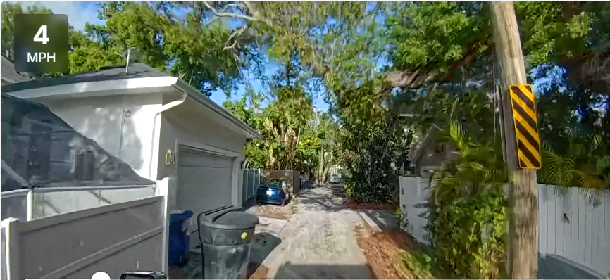
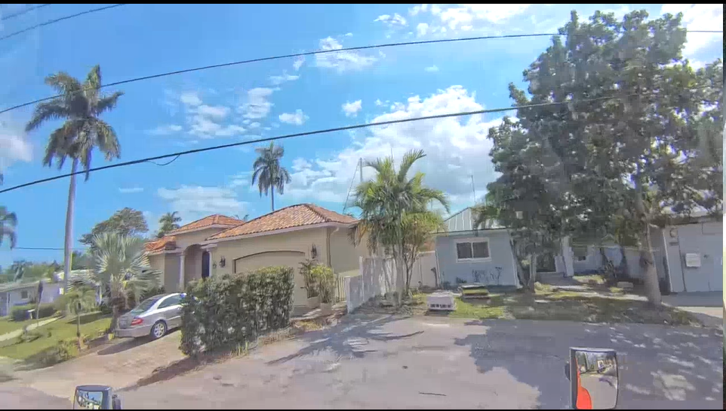
Defensive Driving
LOOK AHEAD
Look ahead 15 seconds when on the highway, or 1-2 blocks when in the city
CHECK ALL SIX SIDES OF YOUR TRUCK
Front, back, both sides, below and ABOVE
Checking all six sides allows you to see potential hazards. In the pictures to the right, looking ahead and above may have prevented the crashes that occurred in these instances.
Low Hanging Trees
Low Clearance Bridge
Low Hanging Trees
Low Hanging Wires

Slide 10

Help Prevent Long Idling
Gas prices are rising — we need your help to reduce long idles!
Less idling means:
    Lower fuel costs
    Less wear on vehicles
    More efficient operations
This is a team effort — every minute counts!
Small changes make a big impact across the fleet.
Turn off the engine if you’re going to be parked for
more than 3 minutes.

Slide 11
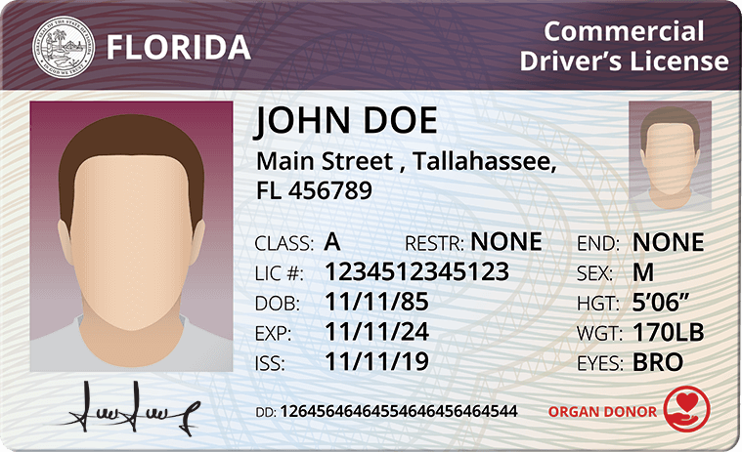
All Drivers MUST Obtain CDL License by December 31
All PODS non-CDL drivers are required to obtain a Commercial Driver’s License (CDL) by the end of the year.
How PODS Helps
PODS will cover Class B CDL training costs up to $3,650 per driver
Rate increase to CDL rate will be applied upon completion and verification of the driver’s license
Please contact your market manager with any further questions.

Slide 12
Storage Center Workers
May 2026

Slide 13
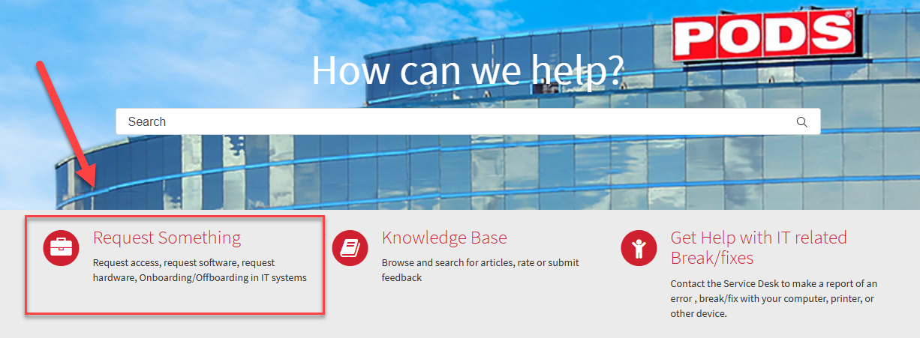
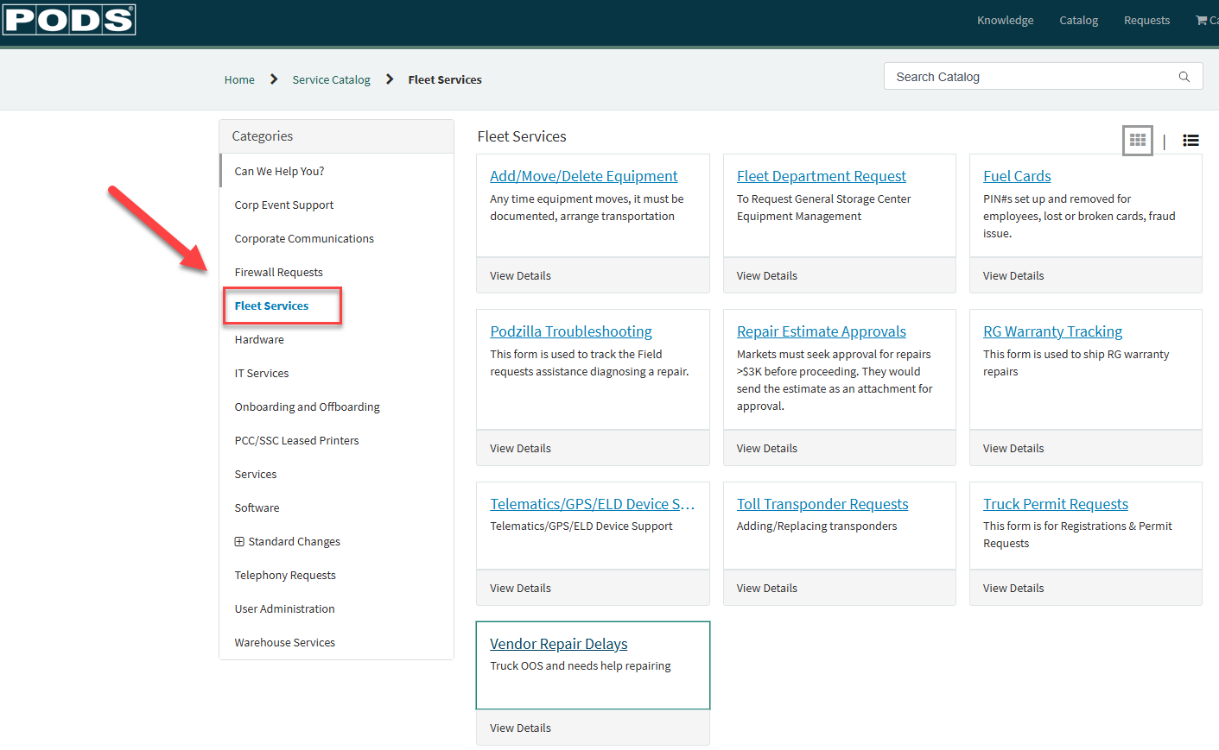
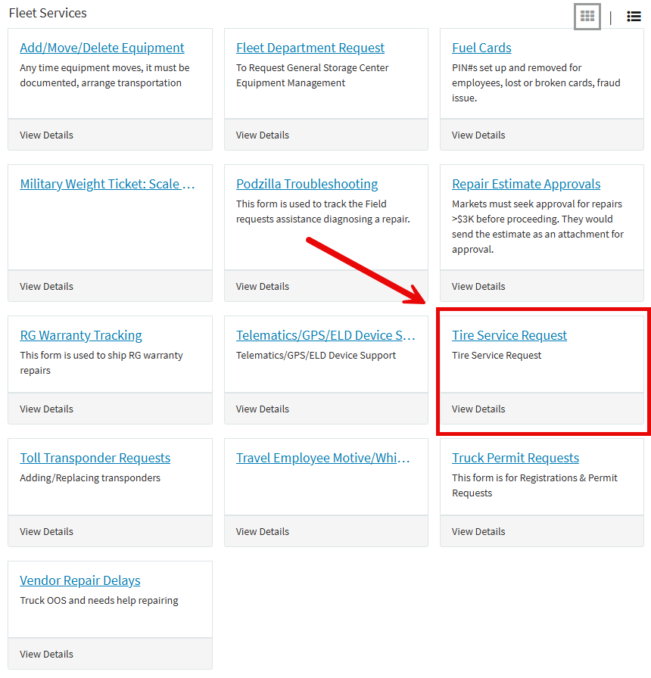
SNOW Ticket Process – Tire Order Assistance
STEP 1: Navigate to Service NOW and Select “Request Something”
Step 2: Select “Fleet Services” then select the correct ticket type to open.
STEP 3: Select Tire Service Request
Step 4: Fill out the form with Location info and Asset Type you’re requesting tires for.
Forklift tires will require a picture of the data plate from the forklift if not on file in the asset wallet.
Fleet Department will action the ticket; you will receive confirmation once completed.

Slide 14

Stop All Steel Roof Replacement-Related Repairs
Effective immediately, we have placed a temporary STOP on all steel roof replacement-related repairs
All teams must stop the following repair types:
Replacement of plastic roofs with steel roofs
Any panel repair that requires removal of a steel roof
Any repair that requires removal of a steel roof, regardless of scope
This temporary stop ensures that we pause execution while we update and standardize training to ensure the highest level of safety and quality across all markets.

