Slide 1
EMT Monthly Meet-Up
Charlie Villemaire, Manager II – Hydraulic Lift Systems
May 2026

Slide 2
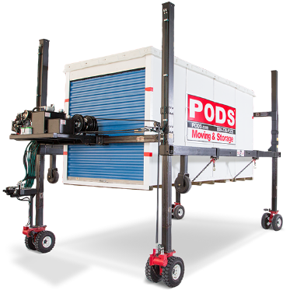

EMT Monthly Meet-Up
Welcome & Purpose of Monthly Meet-Up
Keep all EMTs aligned on best practices, safety, and company requirements
Reinforce collaboration and knowledge sharing
Second Tuesday of Each Month @ 2PM EST
Next call will be June 9, 2026
Mandatory Use of Whip Around
Non-Optional Requirement: All maintenance and repair work must be recorded in Whip Around — no exceptions.
Why it Matters:
  Ensures accurate maintenance history for every unit
  Supports compliance, warranty claims, and preventative maintenance scheduling
  Helps Support EMTs – allows leadership to see and recognize all the hard work being done in the field
Support Available:
  I am available to help each of you individually if you need guidance on using Whip Around or have any issues creating and closing work orders.
Notes:
Go live on Whip Around and discuss procedure for adding Service Tasks

Slide 3

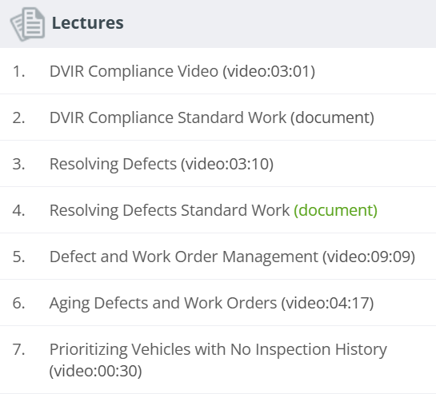
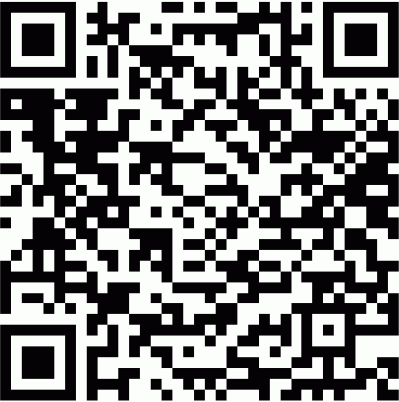
Whip Around Training
PODS University has some quick videos showing how to perform some of the basic tasks in Whip Around.
Use the QR code to access those trainings and watch the short form videos as a quick job aid.
A recorded training session is also available on the Corp Ops Intranet Website which is referenced in the next slide.
Notes:
The best way to get up to speed using Whip Around is to use Whip Around

Slide 4
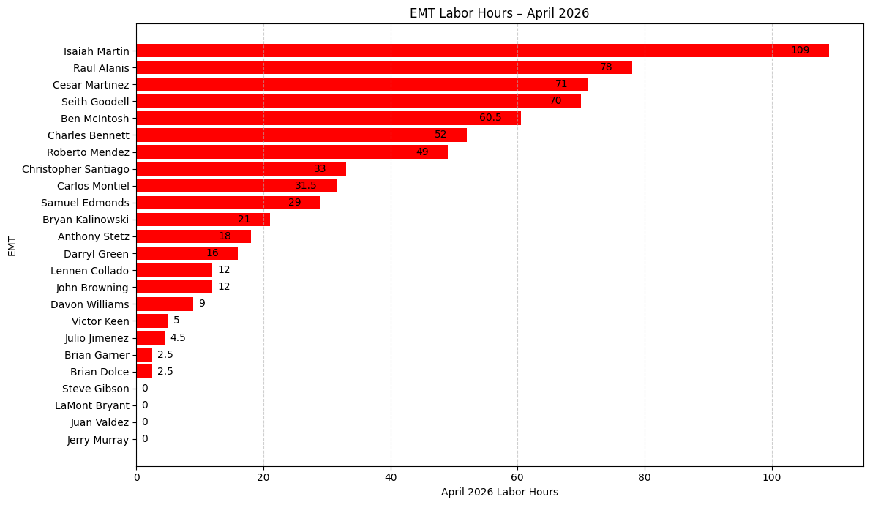
April 2026 EMT Labor Hours
*560 labor Hours with no Assignees

Slide 5
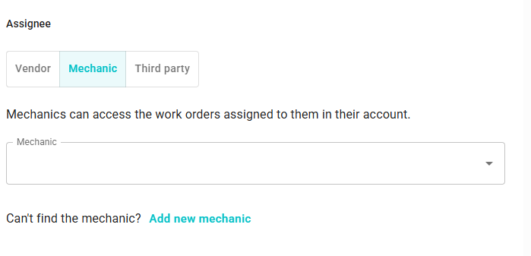
Whip Around Work Order Assignees
We are continuing to identify a high number of closed work orders without an assigned Mechanic.
Prior to closing a work order, EMTs must verify they are selected under Mechanic/Assignee field to ensure labor hours are properly credited.
Fleet Operations is currently working with Whip Around to implement a requirement that an assignee be selected before a work order can be closed.

Slide 6
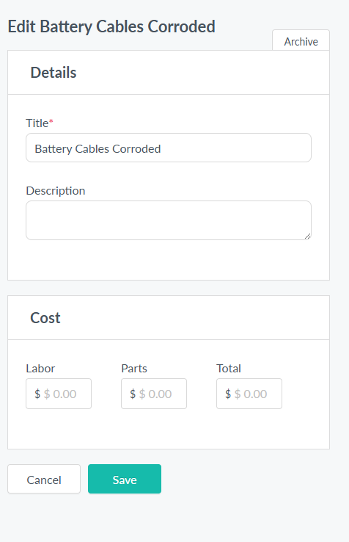
Whip Around Work Order Labor Hours
We also continue to identify a high number of Service Tasks on work orders that do not include labor costs.
This typically occurs when an EMT creates a custom service task but does not enter associated labor cost.
Defects should not be entered as service task.
If a new service task is needed, please contact the Podzilla Fleet Manager for assistance with proper setup.

Slide 7
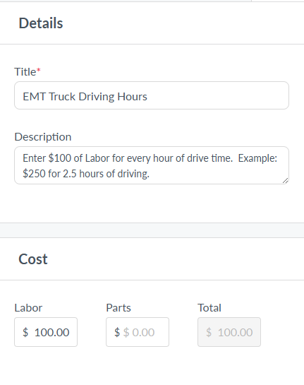
New Service Task – EMT Vehicle Driving Hours
Two ways to input Labor Hours for those EMTs that travel using their EMT Vehicle
Use Service Task ST-0584 (EMT Vehicle Driving Hours) and add it on the Podzilla Work Order that is created for the Podzilla work you traveled for or…
Create a separate Work Order using ST-0584 (EMT Vehicle Driving Hours) and assign it to your EMT Vehicle.
There where zero EMT Truck Driving Hours logged in April

Slide 8
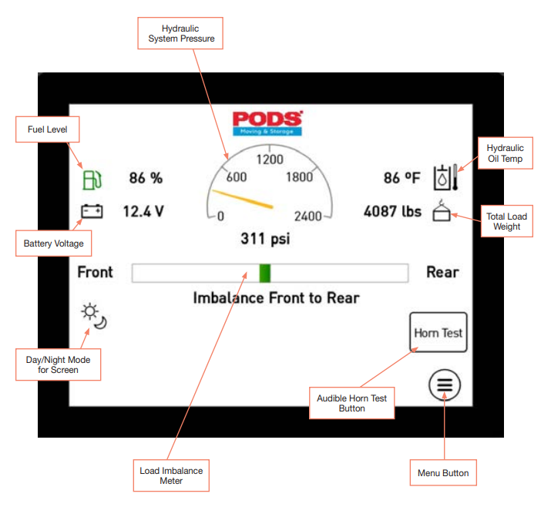
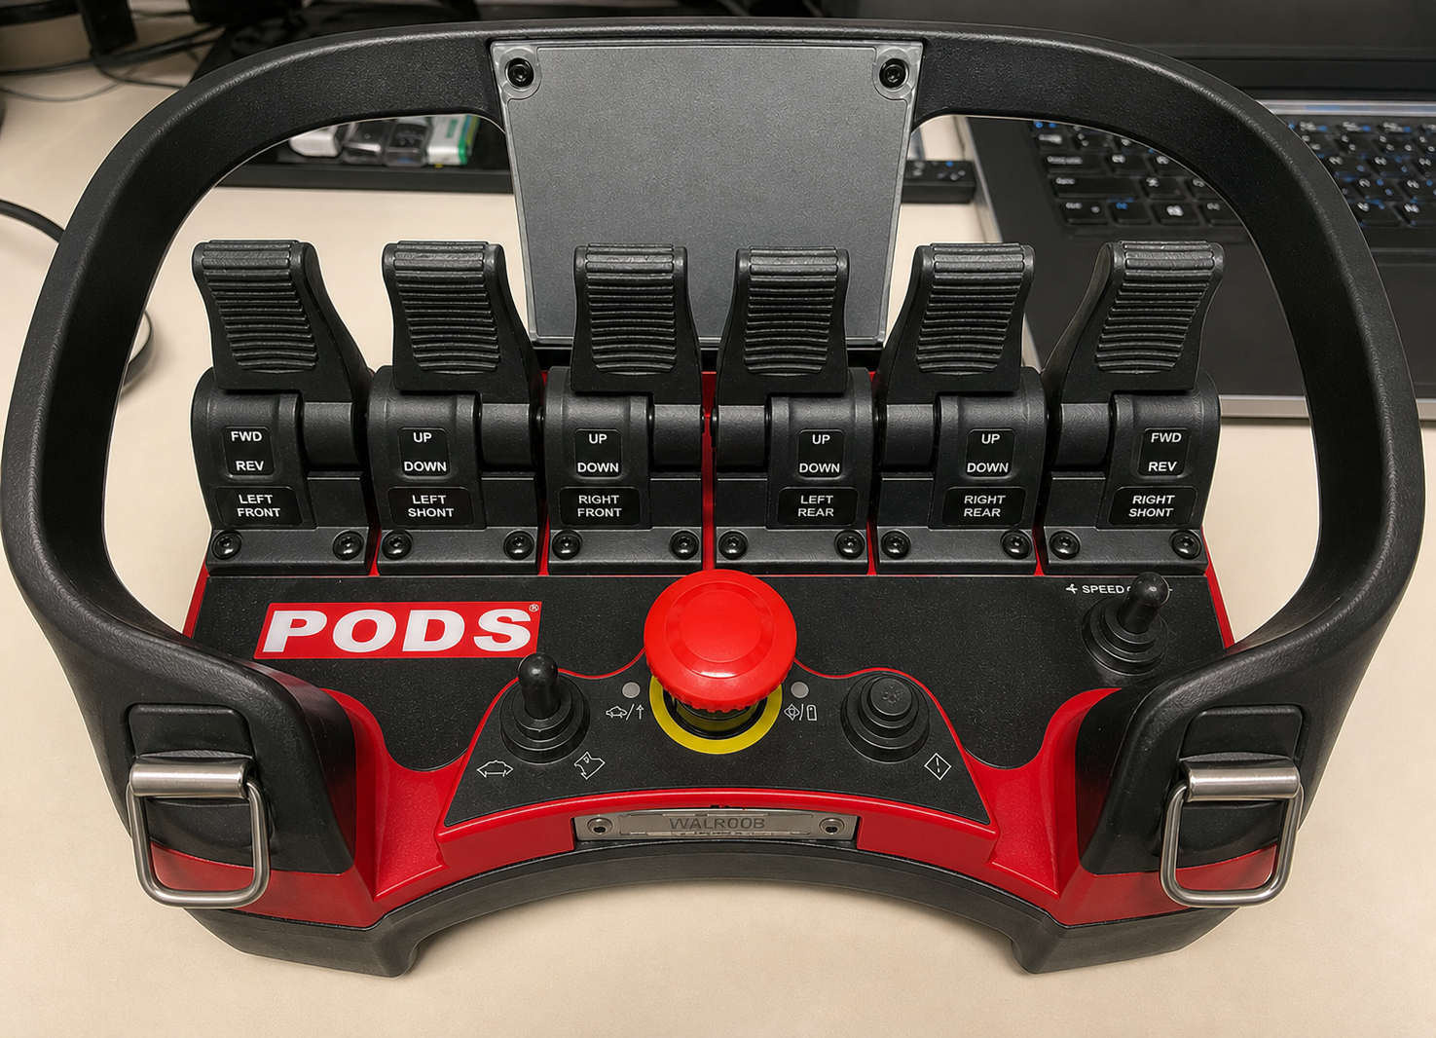
Podzilla DVIR (Legacy Podzilla vs. RG Podzilla)
As of today 5/12/2026, there are (2) Separate Podzilla DVIRs
Legacy Podzilla DVIR, assigned to 879 Assets- No changes
RG Podzilla DVIR, assigned to 455 Assets- Same as Legacy Podzilla with (2) additional checks
  HMI Screen- Verify that the HMI powers up and has no error messages
  Scanreco Remote- Locate Scanreco Remote Belly Box and verify that all remote functions operate properly

Slide 9
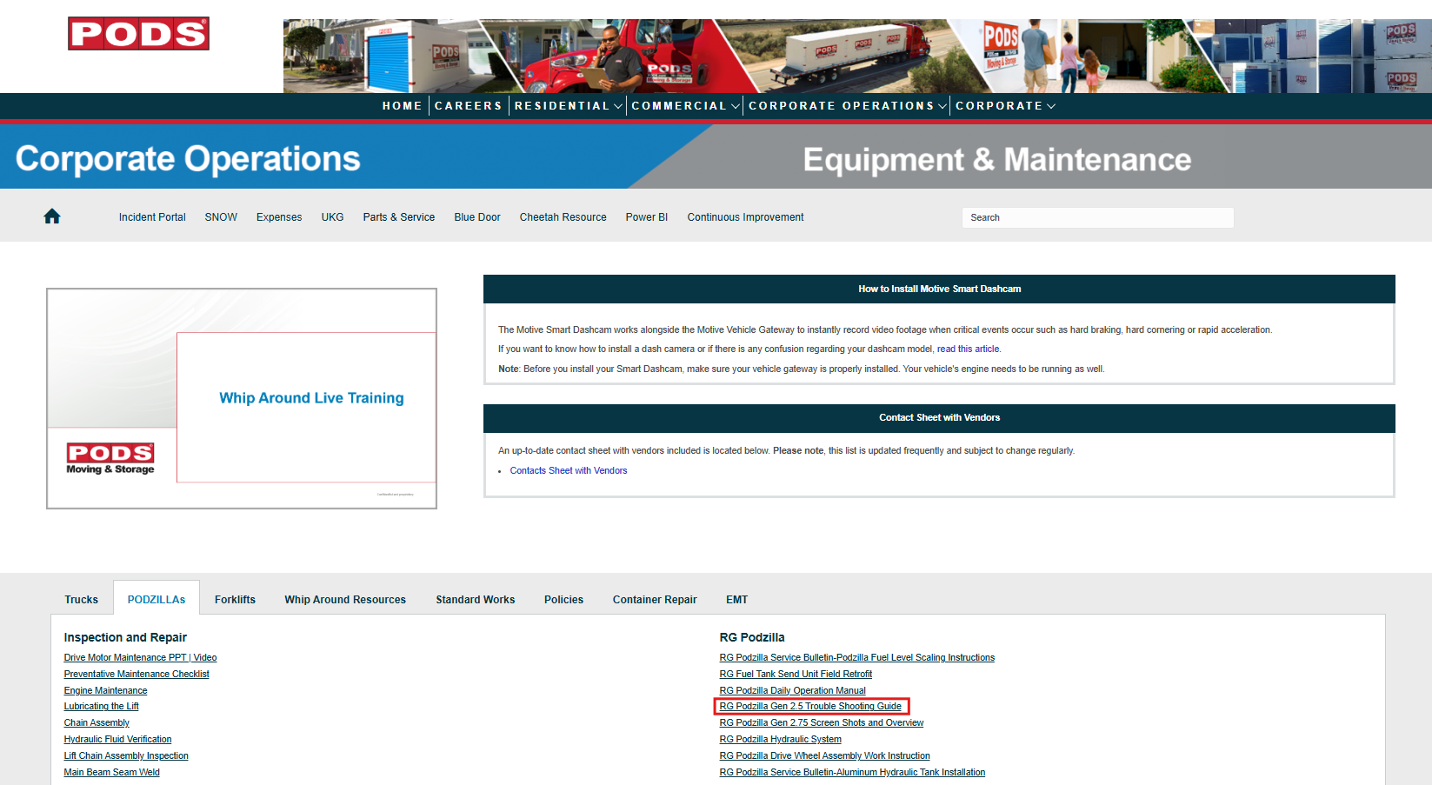
RG Podzilla Gen 2.5 Troubleshooting Guide

Slide 10
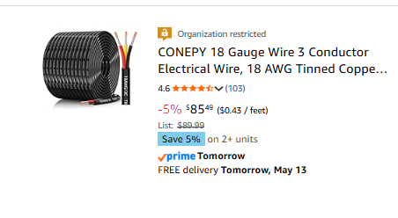
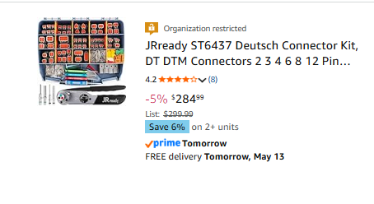
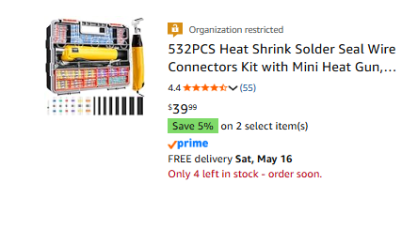
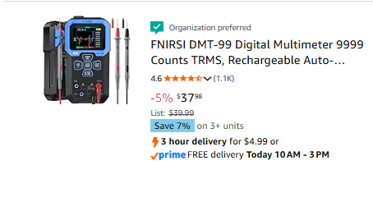
RG Podzilla Electronic Repair Supplies-EMT List on Amazon Business Account

Slide 11
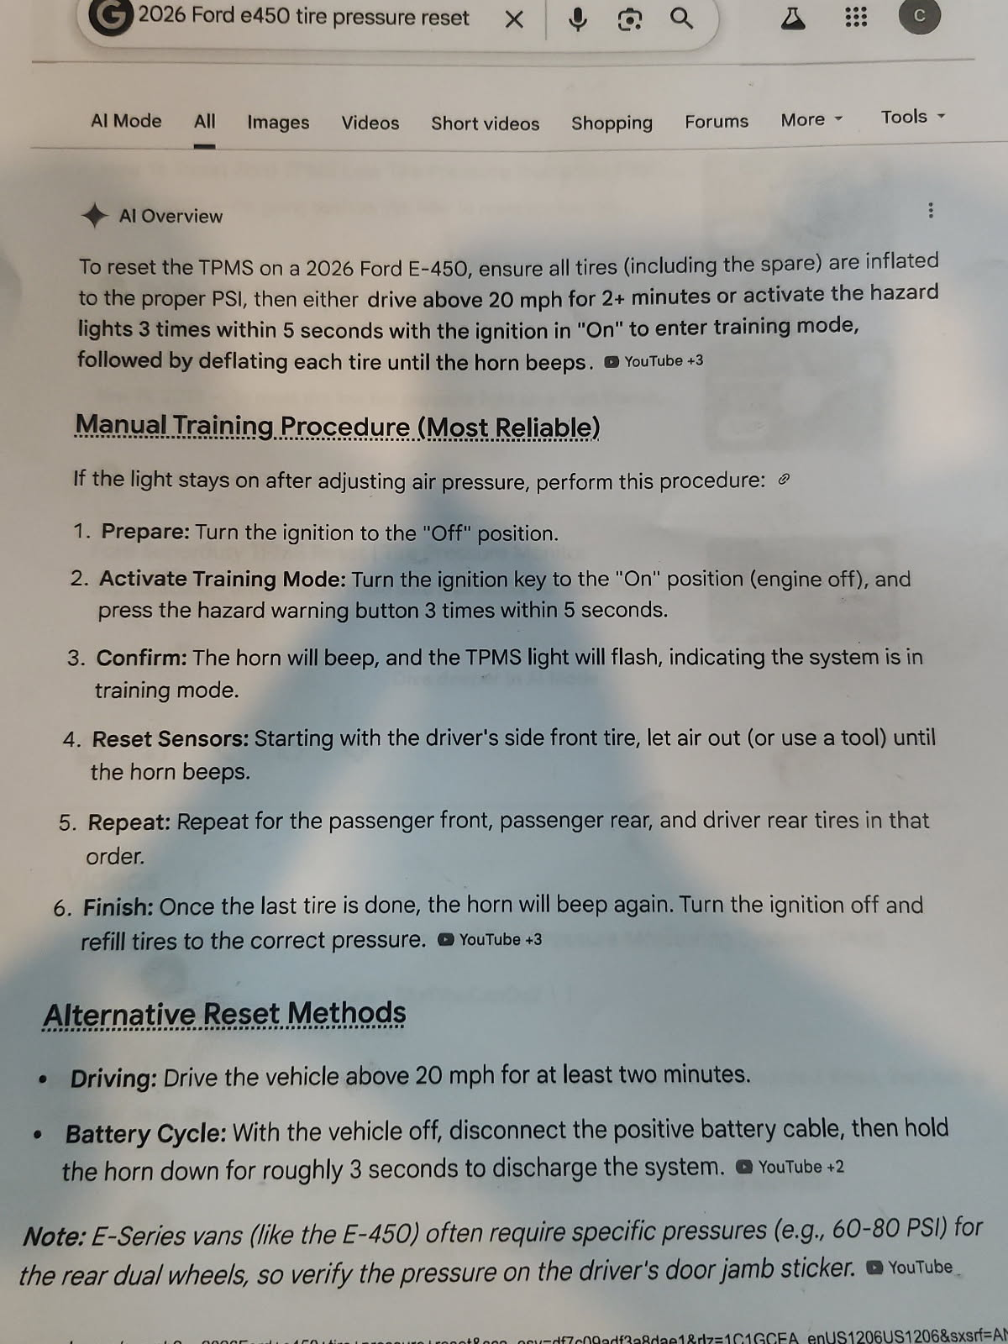
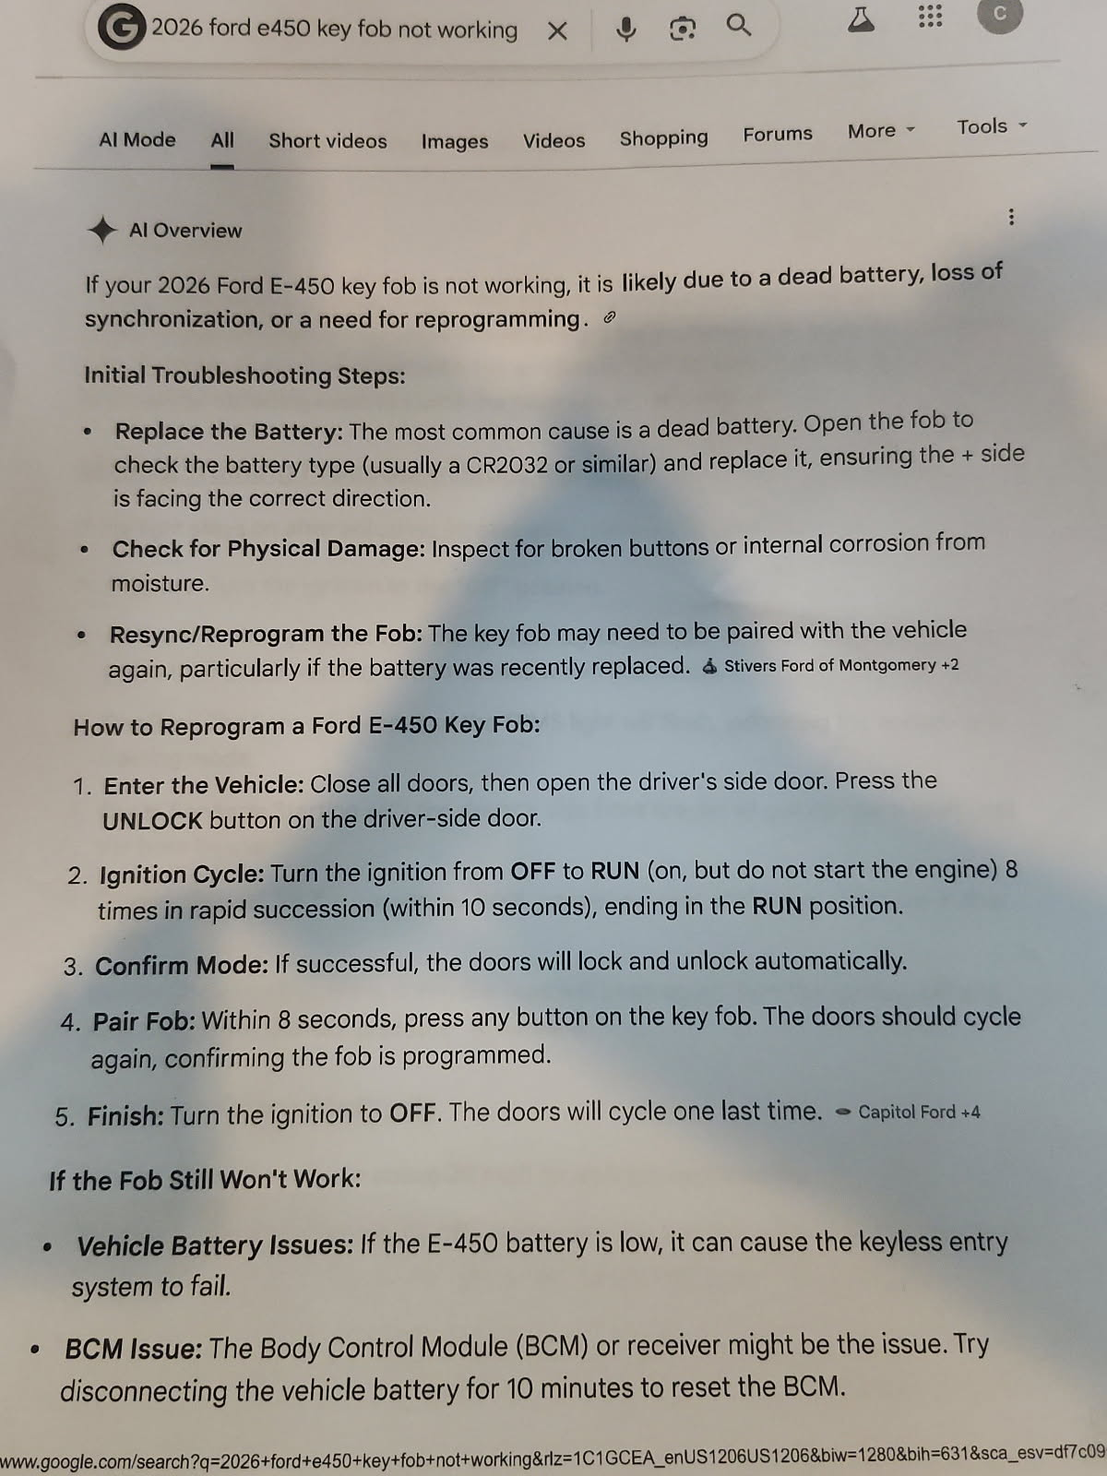
EMT Ford F-450 Key FOB & TPMS Reset

Slide 12
Q&A Open Forum
Q & A

