Slide 1
Podzilla Portable Lighting Safety & Compliance Update
Charlie Villemaire, Podzilla Fleet Manager
1/29/2026

Slide 2
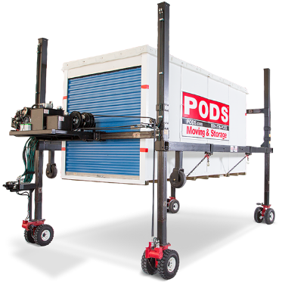
Why This Matters
Low-Light Podzilla Operations create recognized Hazards.
Struck-by and visibility risks exist
Notes:
Go live on Whip Around and discuss procedure for adding Service Tasks

Slide 3
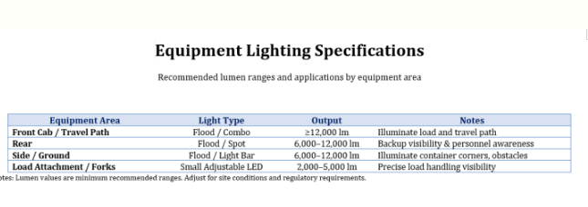
Program Objectives
Goals
Improve visibility during low-light Podzilla operations
Reduce struck-by and obstacle hazards
Standardize equipment and usage across the fleet
Create clear, auditable standards for Safety & Legal
Design Principles
Portable (not permanent vehicle lighting)
Deployed only when needed
Removed after job completion
Simple, repeatable, and enforceable
Notes:
The best way to get up to speed using Whip Around is to use Whip Around

Slide 4
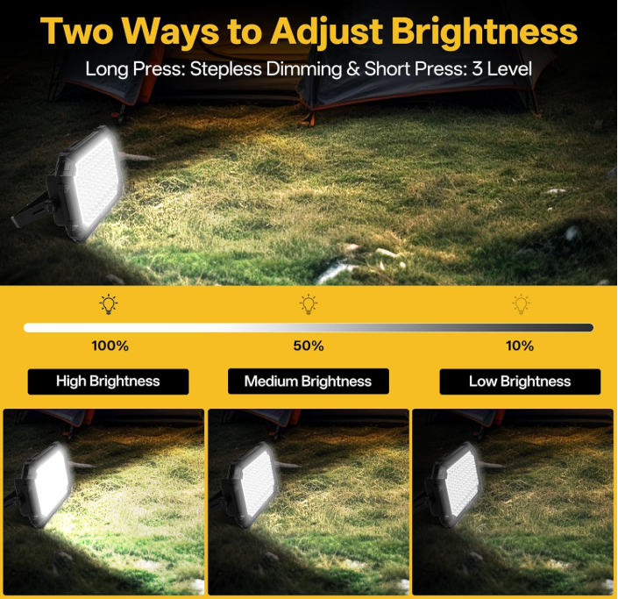
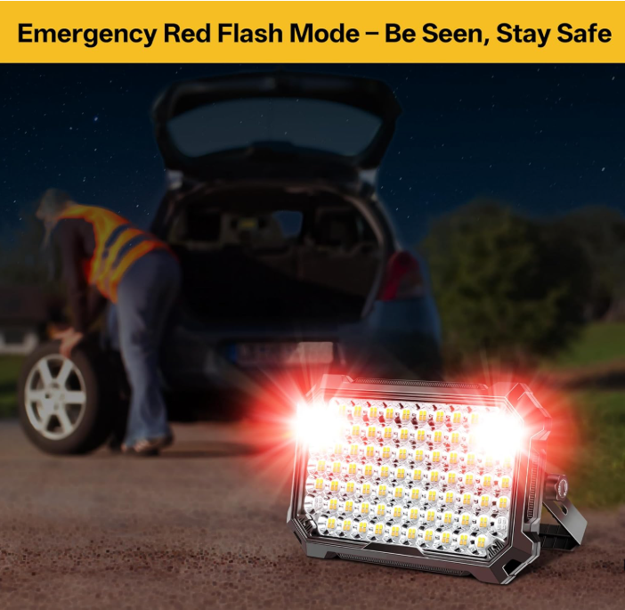
Solution Overview- Nickluc LED Portable Work Flood Lights
What Was Implemented:
Portable, battery-powered LED work lights
High-output flood lighting for operational visibility
USB rechargeable for fleet practicality
Key Design Decision:
Lights are temporary task lighting, not permanent fixtures
Prevents road-use compliance issues
Keeps solution narrowly focused on safety need
LED Work Light Rechargeable Outdoor, 12,000mAh Work Flood Lights 10,000LM with 4 Light Modes as Power Bank for Camp Essentials, IP65 Waterproof.

Slide 5
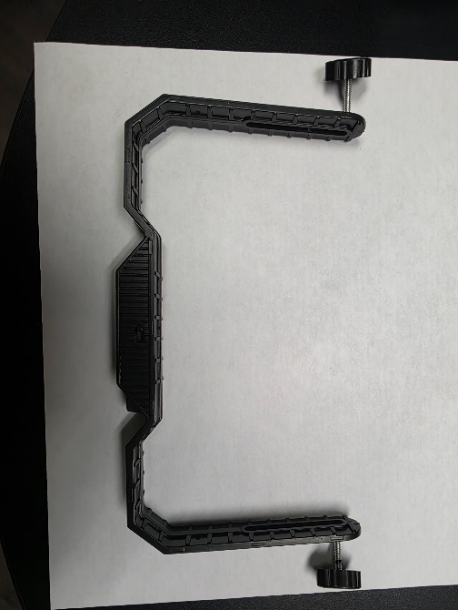
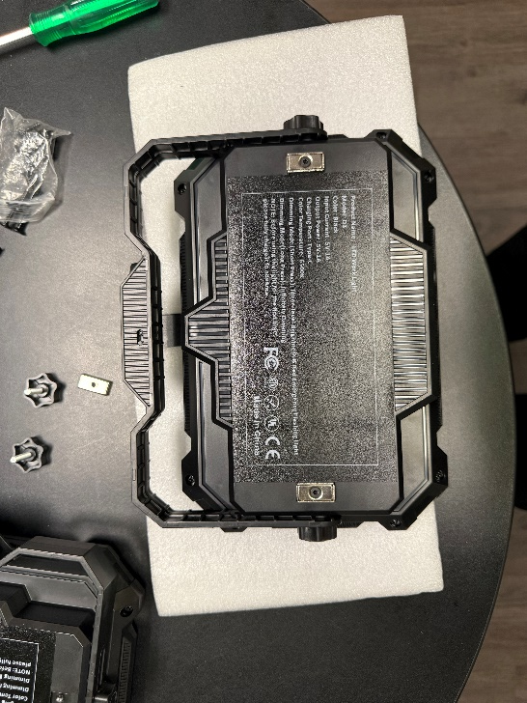
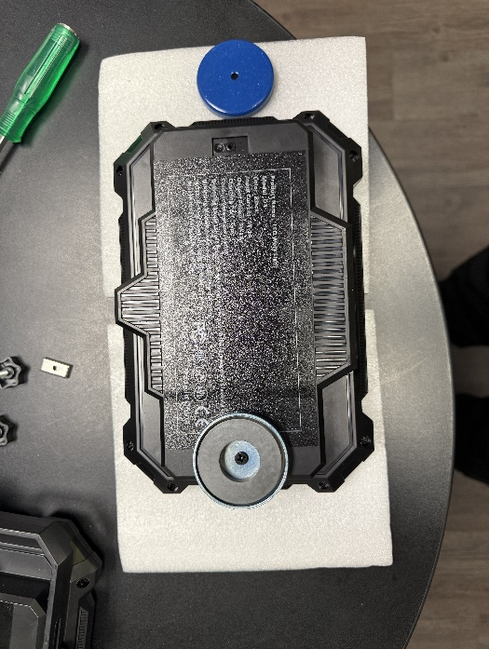
Equipment Risk Identified & Mitigated
Issue Discovered During Testing
Factory-installed magnets were not suitable for:
Vibration
Outdoor industrial use
Repeated deployment on steel structures
Risk
Dropped object hazard
Equipment damage
Potential injury exposure
Mitigation
Upgraded to PODS high-retention container magnet Part # (RCU911) (available on PODS Parts Portal)
Removed nonessential components (handle) to improve fitment.

Slide 6
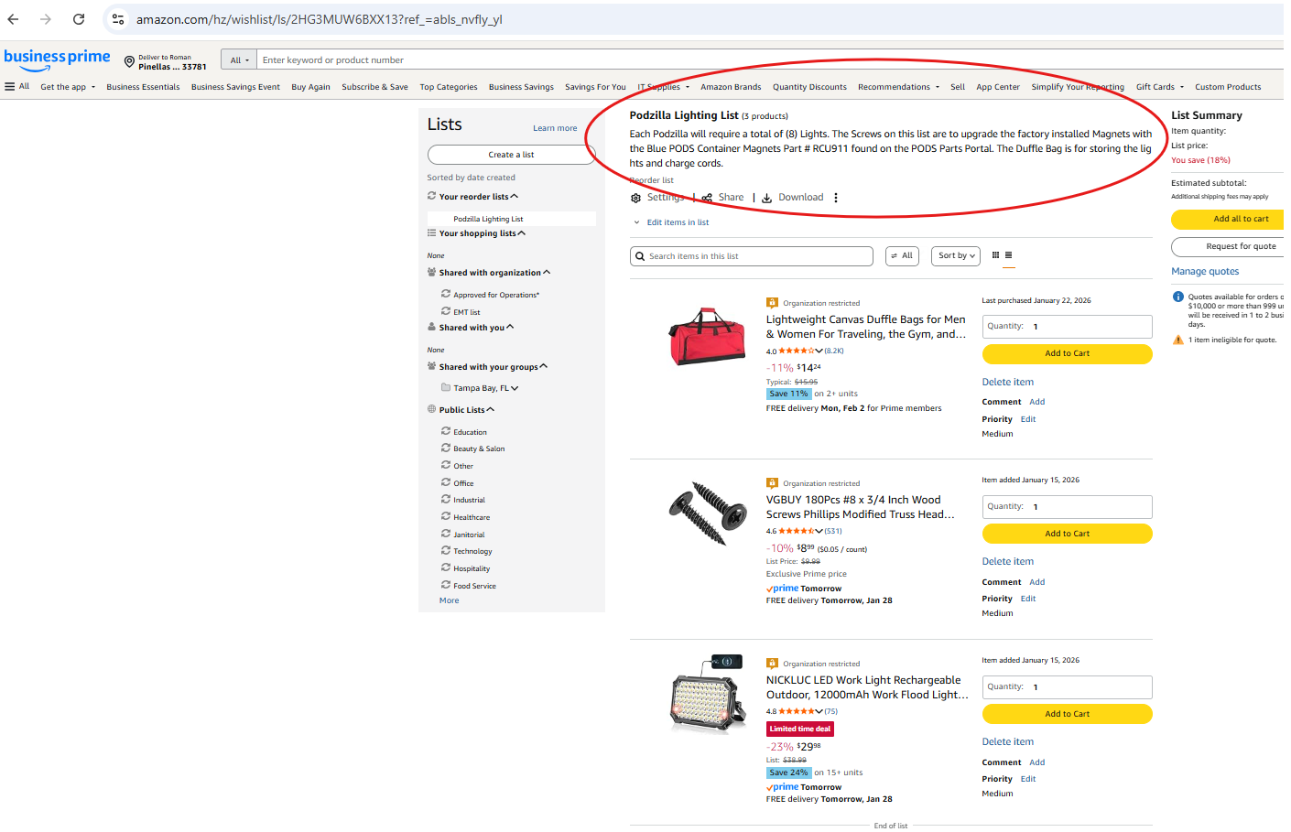
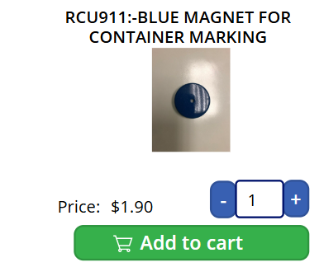
Procurement
All items can be purchased on the Amazon Business Account and the PODS Parts Portal. You will need (8) Nickluc 10,000 lumen LED Lights, or equivalent, (1) box of # 8 ¾” Screws, and (1) Duffle Bag (24” x 12” x 11.5”) for each Podzilla. You will also need a total of (16) Blue Container Magnets, Part # RCU911 for each Podzilla
Amazon Podzilla Lighting List Link : https://a.co/90eW9KK

Slide 7
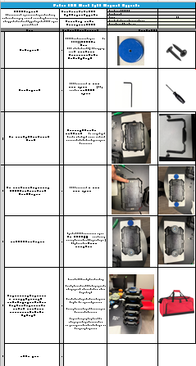
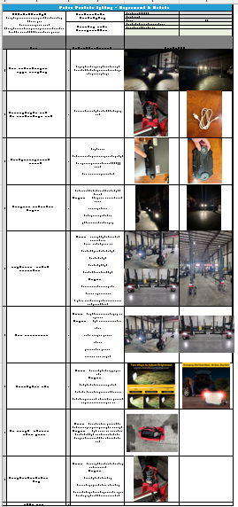
Two Standard Works Created (Governance)
To ensure clarity and accountability, the program was split into two separate Standard Works:
Standard Work 1 – LED Light Modification
Audience: EMT / Fleet / Maintenance
Scope:
  Remove handle
  Replace factory magnet
  Verify retention
  Proper storage
One-time modification per light
Standard Work 2 – Operational Use
Audience: Drivers / Operations
Scope:
  When lights are used
  Where lights are placed
  How lights are removed and stored
Applied per job, only in low-light conditions
This separation prevents role confusion and improves auditability.

Slide 8
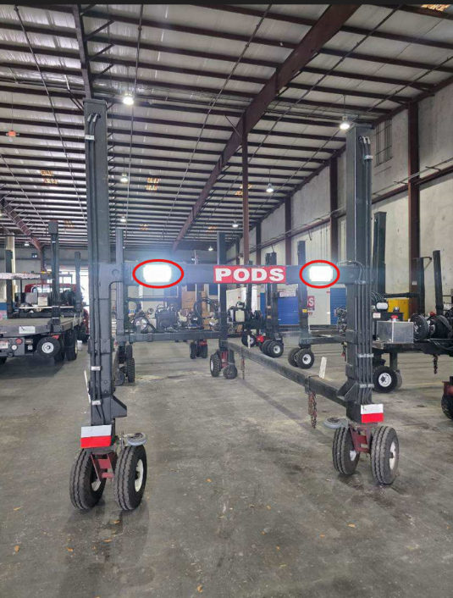
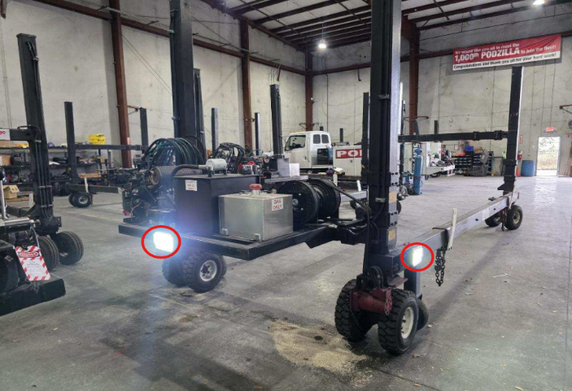
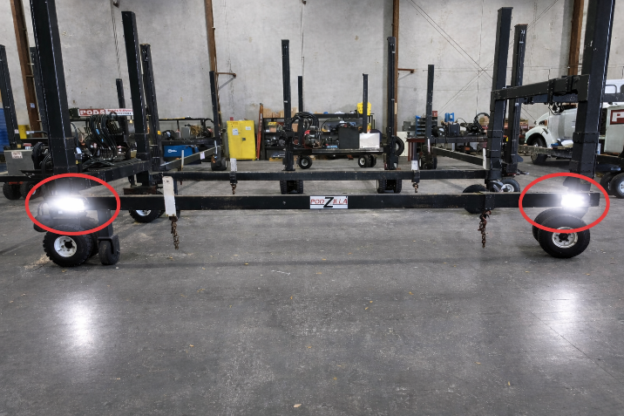
Operational Controls (Safety Focus)
Use Controls
Lights used only in low-light conditions
Not used in daylight or adequate site lighting
Removed immediately after job completion
Never left mounted during transit
Placement Controls
Standard recommended mounting locations
Flexibility allowed to address site-specific strike risks
No interference with moving components

Slide 9
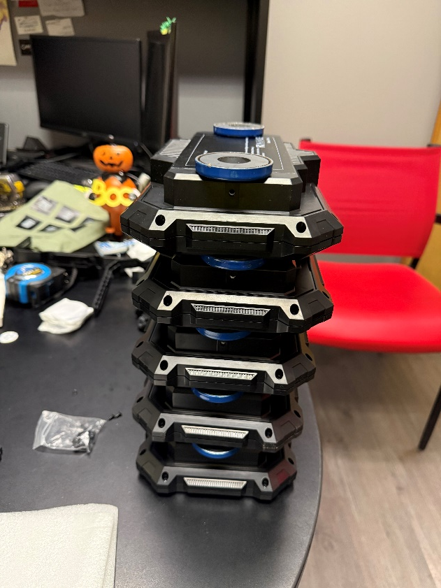
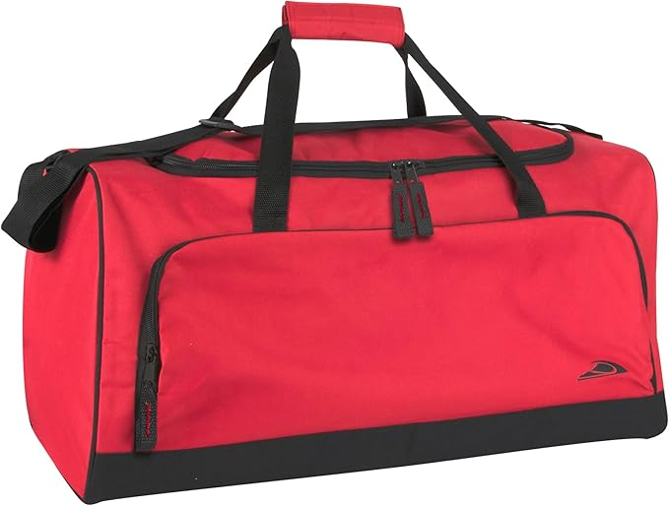
Current Status
Progress to Date
  Lighting solution selected and tested
  Magnet upgrade solution validated
  Two Standard Works Created
  Storage and handling standards defined
What This Provides
  Clear documentation
  Consistent field execution
  Defensible safety position
Next Steps
  Rollout to Ops via Standard Works
  Manager communication and awareness
  Spot audits for consistency
  Monitor feedback and field effectiveness

Slide 10
Q&A Open Forum
Q & A

