Slide 1
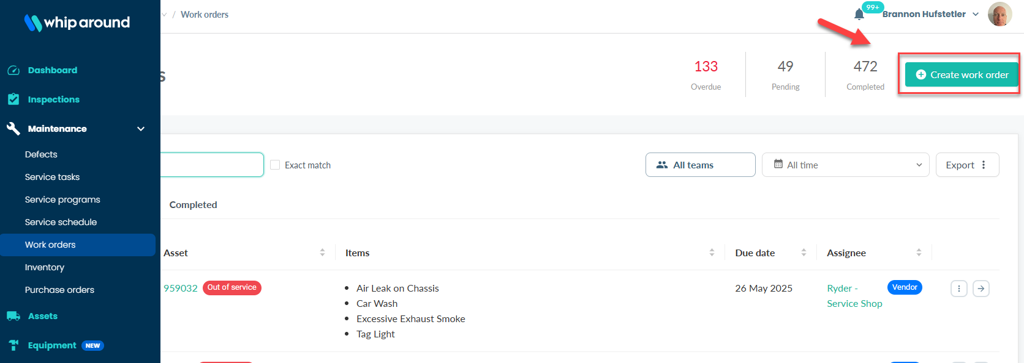
Update PMs – Backdate Work Orders
Best practice for updating PMs on equipment is to open a Work Order. If the PM was performed prior to today, open a Work Order and back date it to reflect when it was completed. Below are the steps to efficiently complete this task.
Step 1: Navigate to the Maintenance tab, select Work Orders, and select “Create Work Order”.

Slide 2
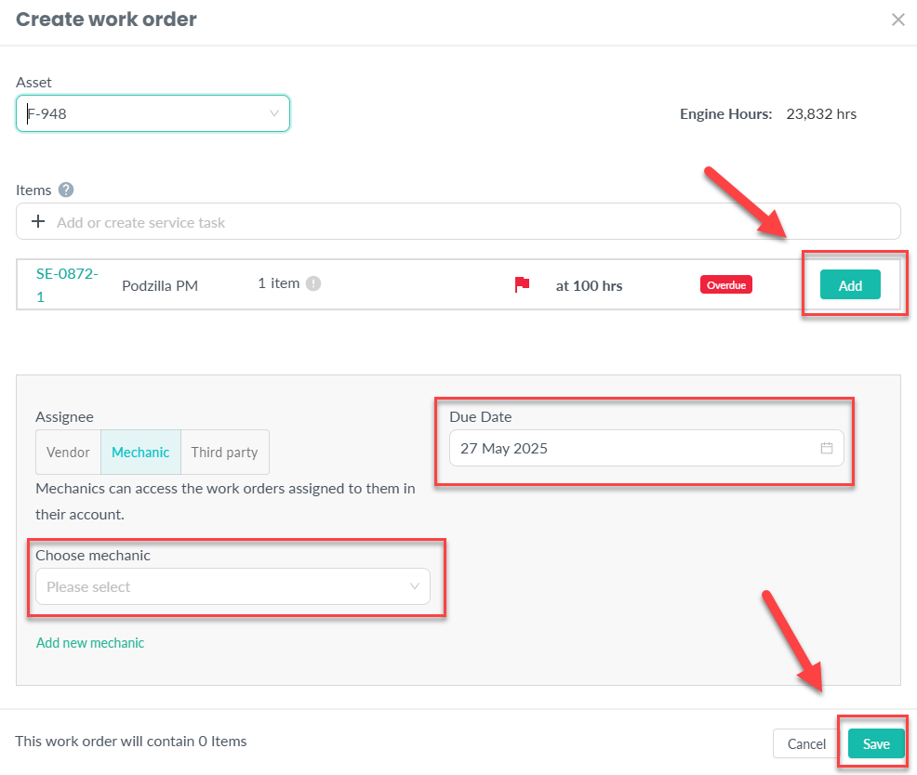
Update PMs – Backdate Work Orders
Step 2: Type in the Asset# and select the PM that is showing overdue.
You have the option to add a vendor or a mechanic and you can back date the due date to the day the PM was performed.

Slide 3
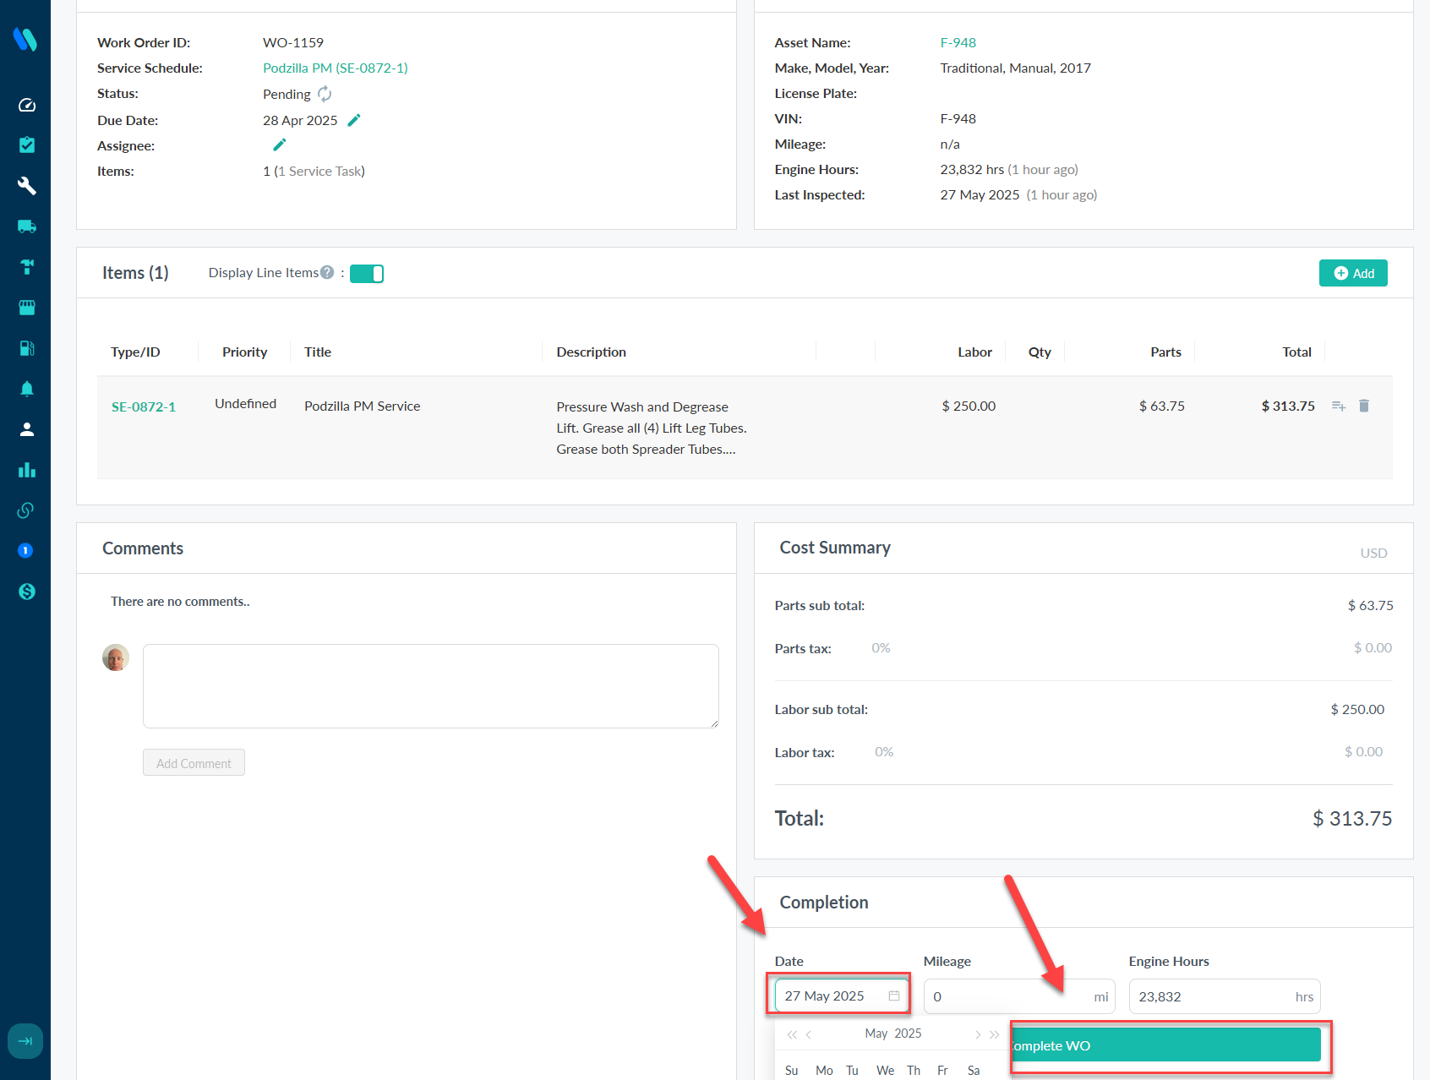
Update PMs – Backdate Work Orders
Step 3: Search & select the Work Order you just opened, back date the completion date (if applicable) and then click “Complete WO”.
This will reset the PM schedule on your asset.

Slide 4
Appendix
Training Resources on next slides

Slide 5

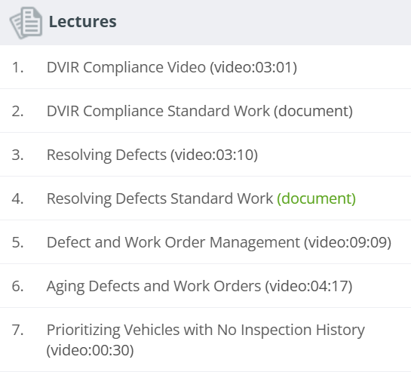
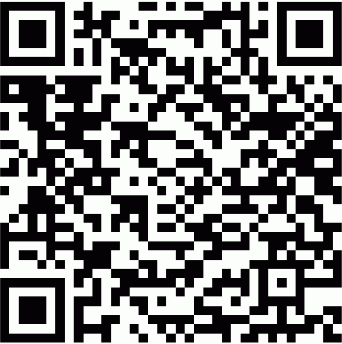
Whip Around Training
PODS University has some quick videos showing how to perform some of the basic tasks in Whip Around.
Use the QR code to access those trainings and watch the short form videos as a quick job aid.
A recorded training session is also available on the Corp Ops Intranet Website which is referenced in the next slide.

Slide 6
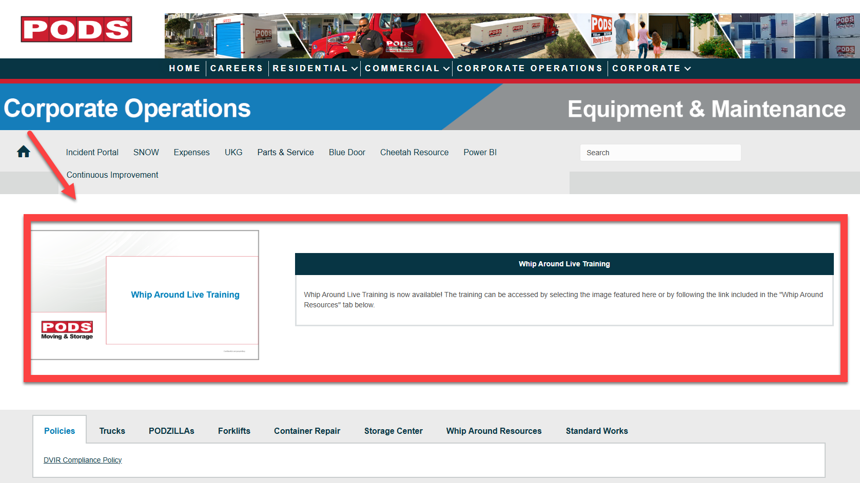
Equipment & Maintenance Website
Please refer to the Corporate Operations Intranet Site for a wide range of technical manuals and troubleshooting guides related to Fleet Operations.
Link: https://wearepodsintranet.pods.com/corporate-operations-equipment-maintenance/
The Video at the top of the page is one of our recorded Whip Around training sessions.
Watch it for detailed training around the tasks that Users will be required to complete.

