Slide 1

Forklift Service Request Process
Brannon Hufstetler – Dir. Capacity Planning

Slide 2
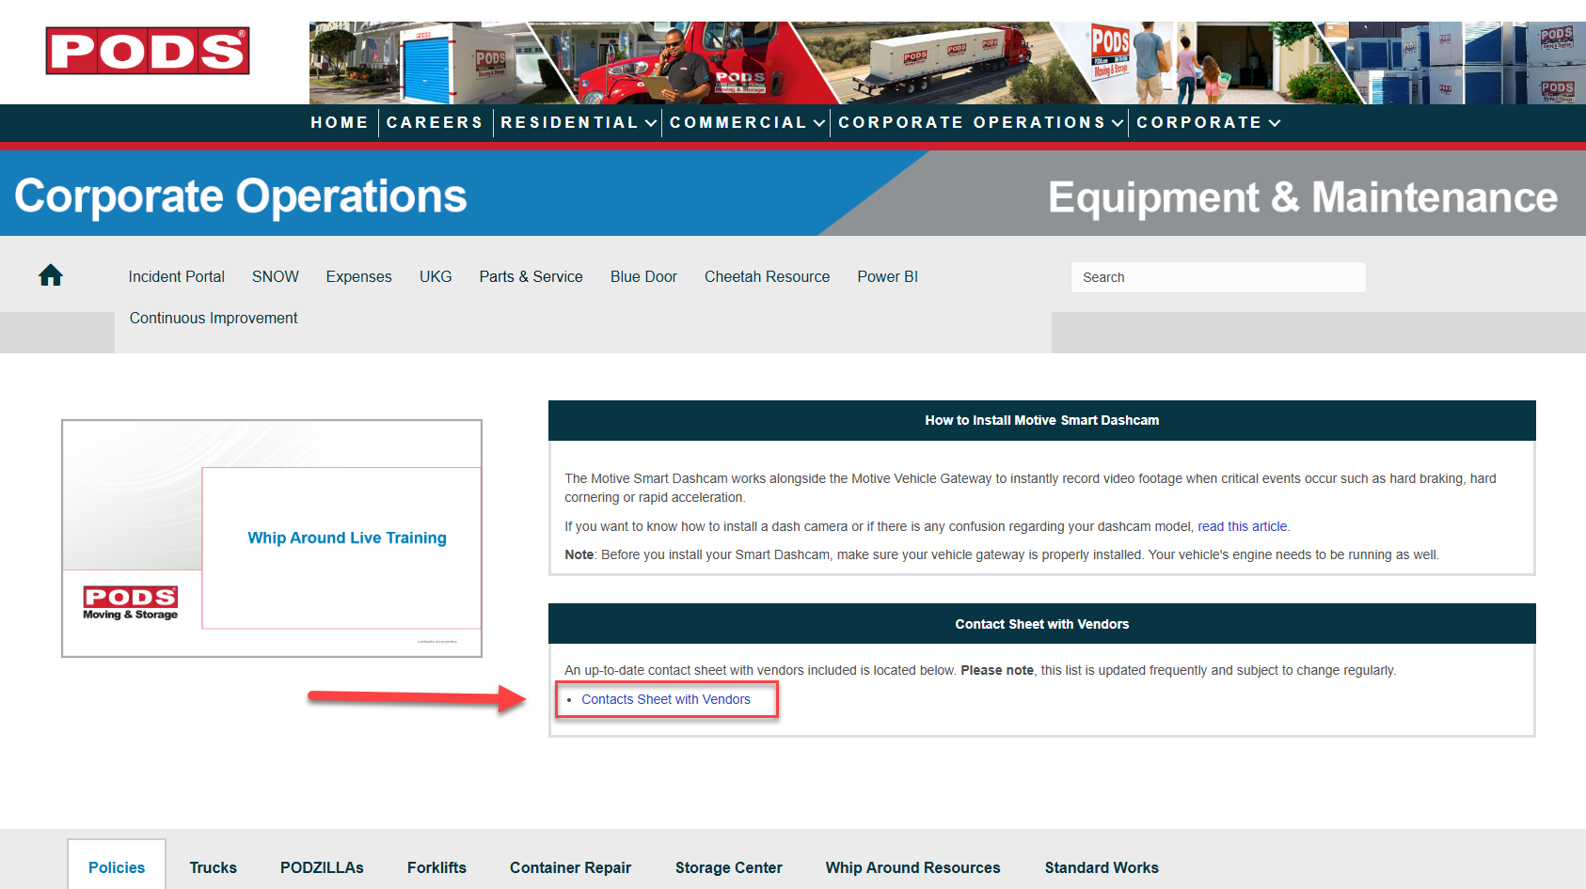
Forklift Service Request Process
Yale & Hyster Forklifts
ALL Maintenance Request (except tires)
Email fleet.mailboxes@hyster-yale.com – This is HYG’s Central Dispatching Team
  Forklift Serial# in Subject Line (Not Asset#)
  Explain in detail the reason why you are requesting service
  HYG Dispatchers will respond with a WO# and ask the local vendor to schedule a mechanic
Hyundai Forklifts
ALL Maintenance Request (except tires)
All Hyundai maintenance is handled directly with local dealership (no central dispatching team)
Establish a relationship with the local service manager
Hyundai Contacts are located on the Fleet Website in the Contact List for each Market (See Screenshot)
  Link: https://wearepodsintranet.pods.com/corporate-operations-equipment-maintenance/

Slide 3
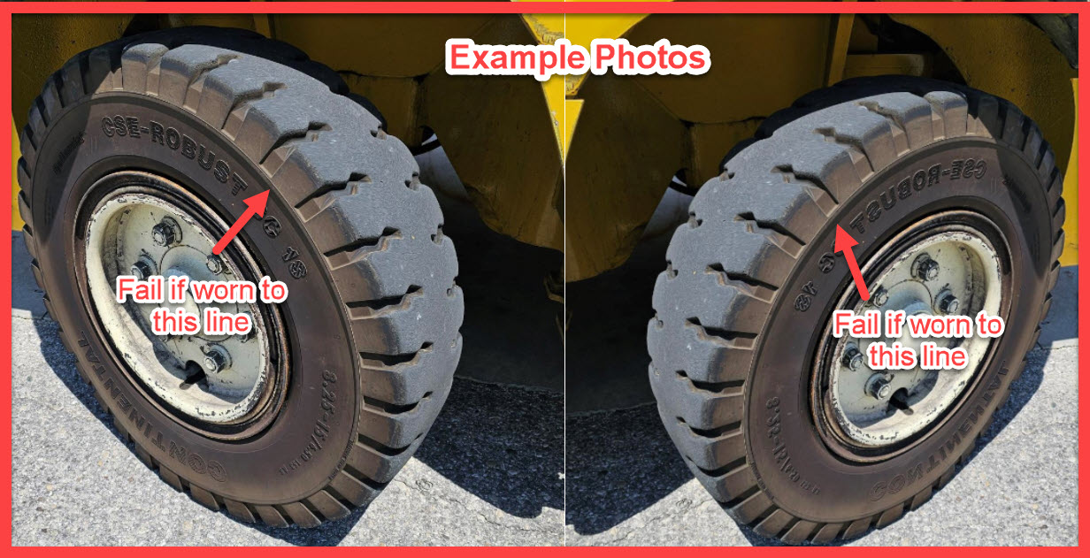
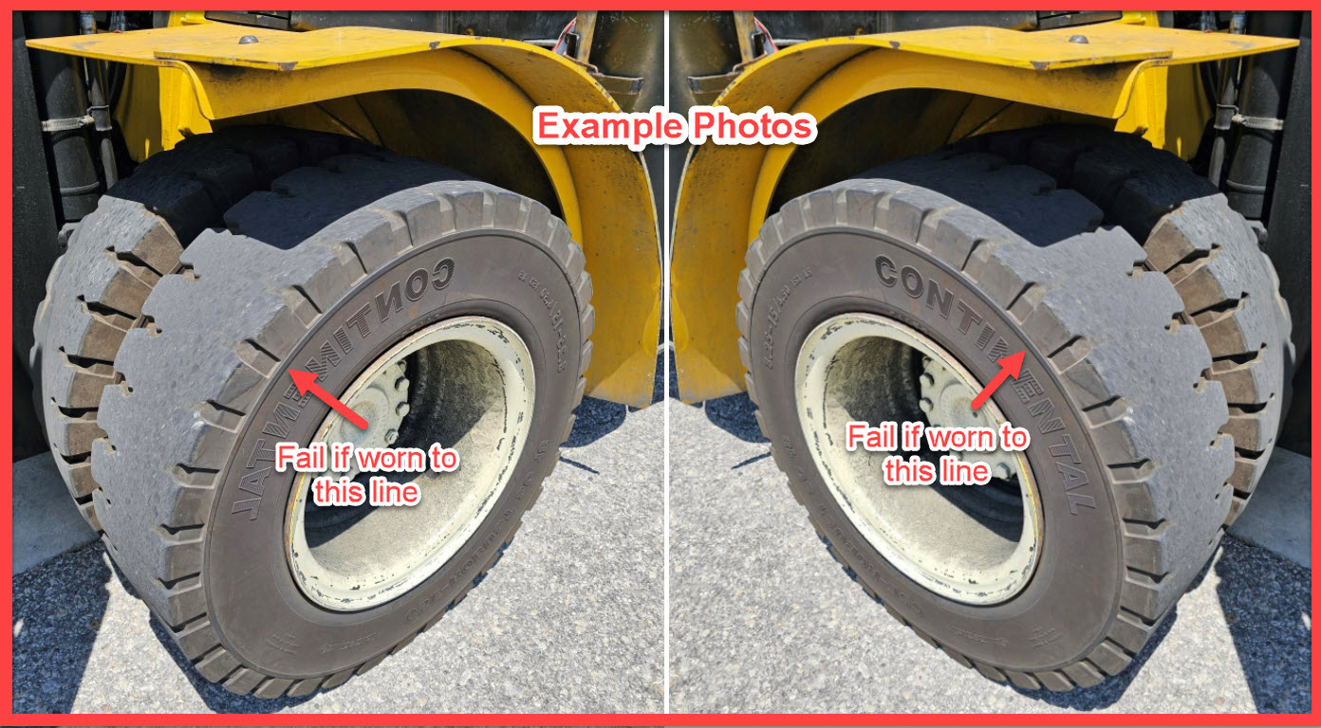
Forklift Tire Order Process Updated 7/23/25
STEP 1 – Proper inspections of the tires are required. Solid tires do not need to be replaced until they are within a half inch of the wear line.
(See Examples for drive/steer tires)

Slide 4
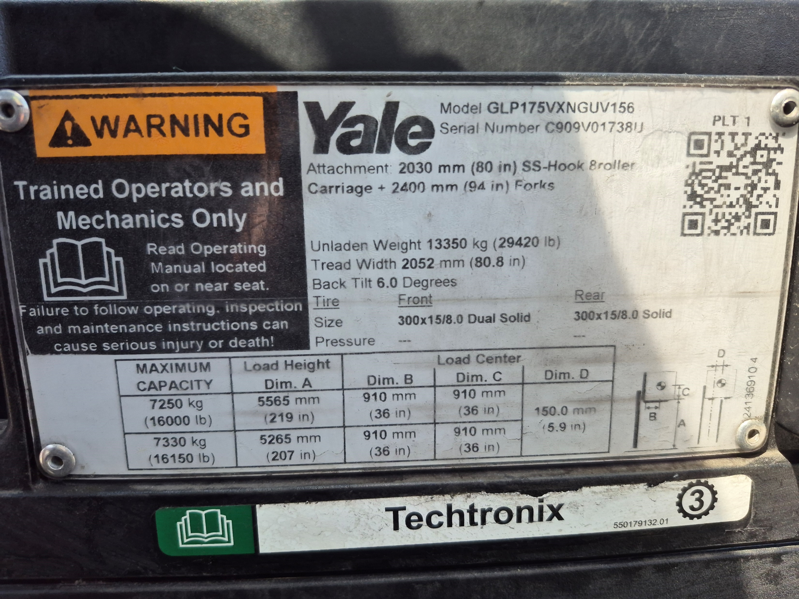

Forklift Tire Order Process Updated 7/23/25
Step 2 – Email Brannon Hufstetler a picture of the data plate showing the tire size and Storage Center address.
You will be copied on the quote and approval email chain.
Caution
Do not order tires through your forklift Vendor, we have a National Account with Continental Tire and they will handle installation and disposals of the old tires.

Slide 5
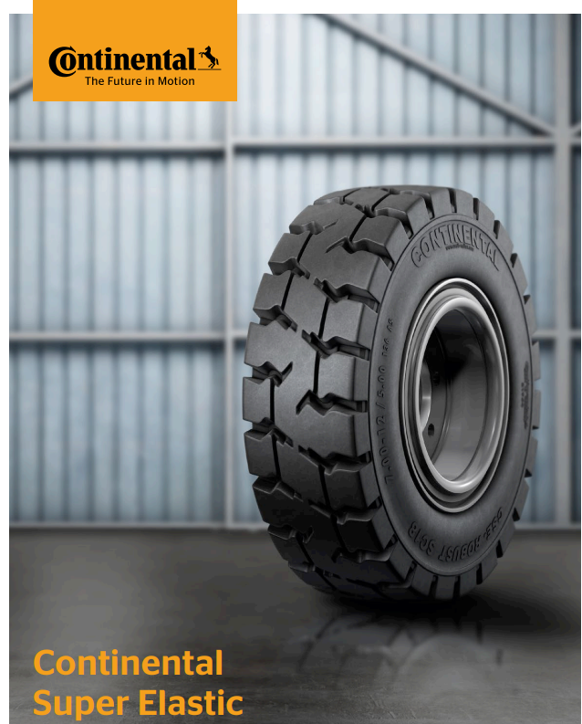
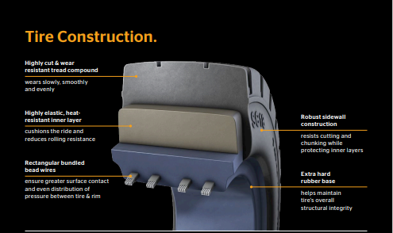
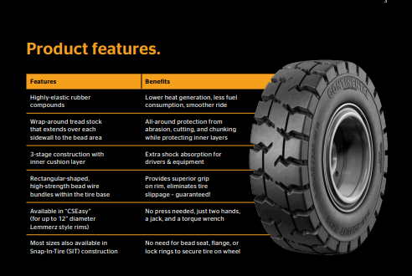
Appendix Updated 7/23/25

