Slide 1
Forklift filter kits
March 2024

Slide 2

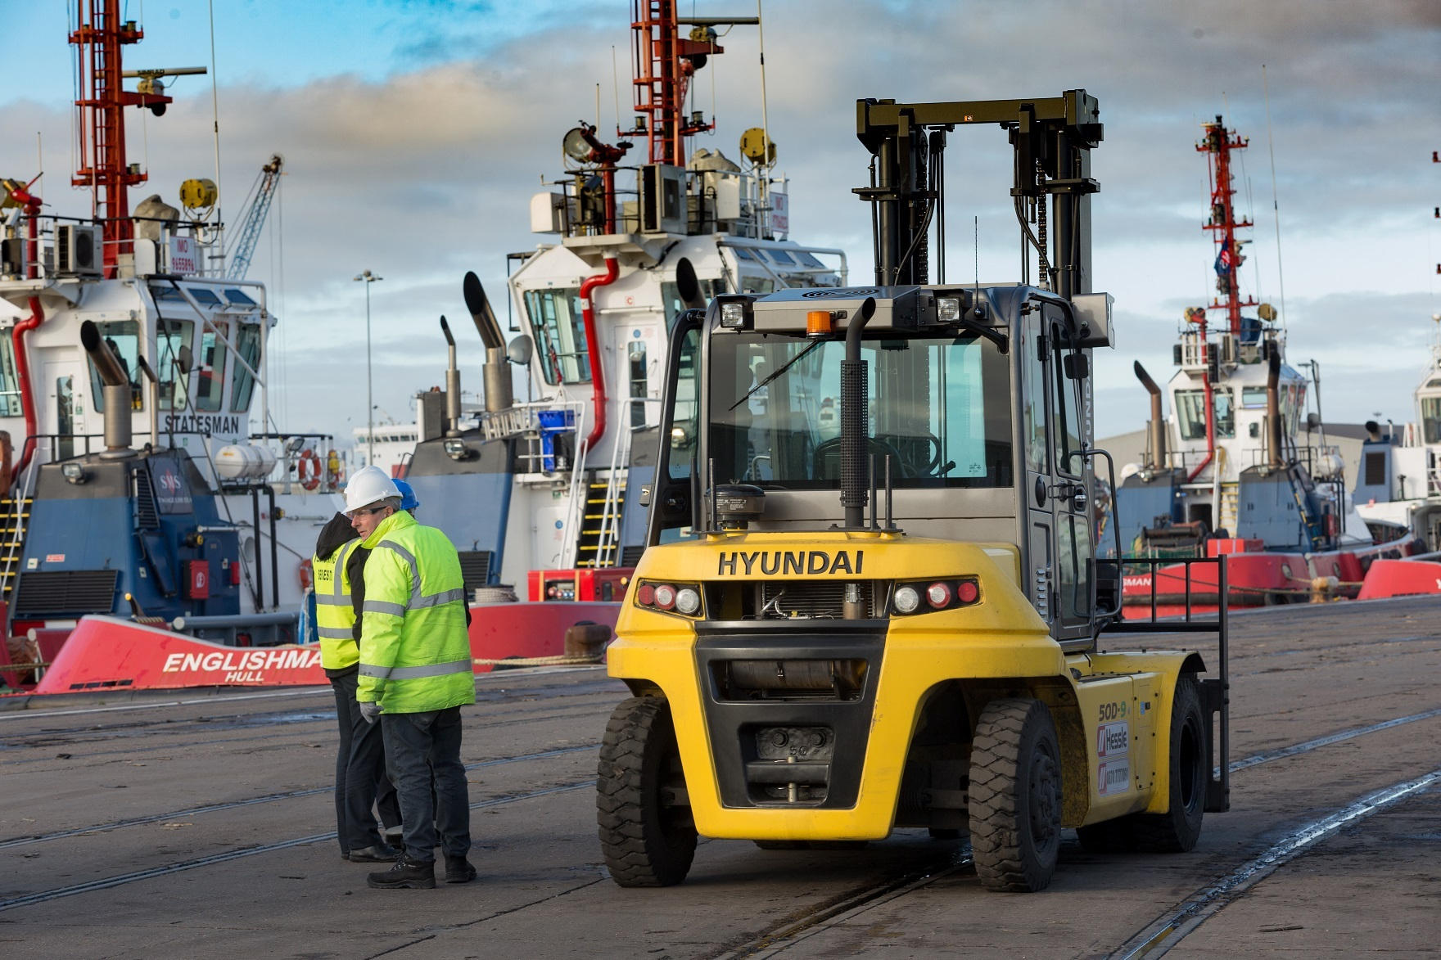
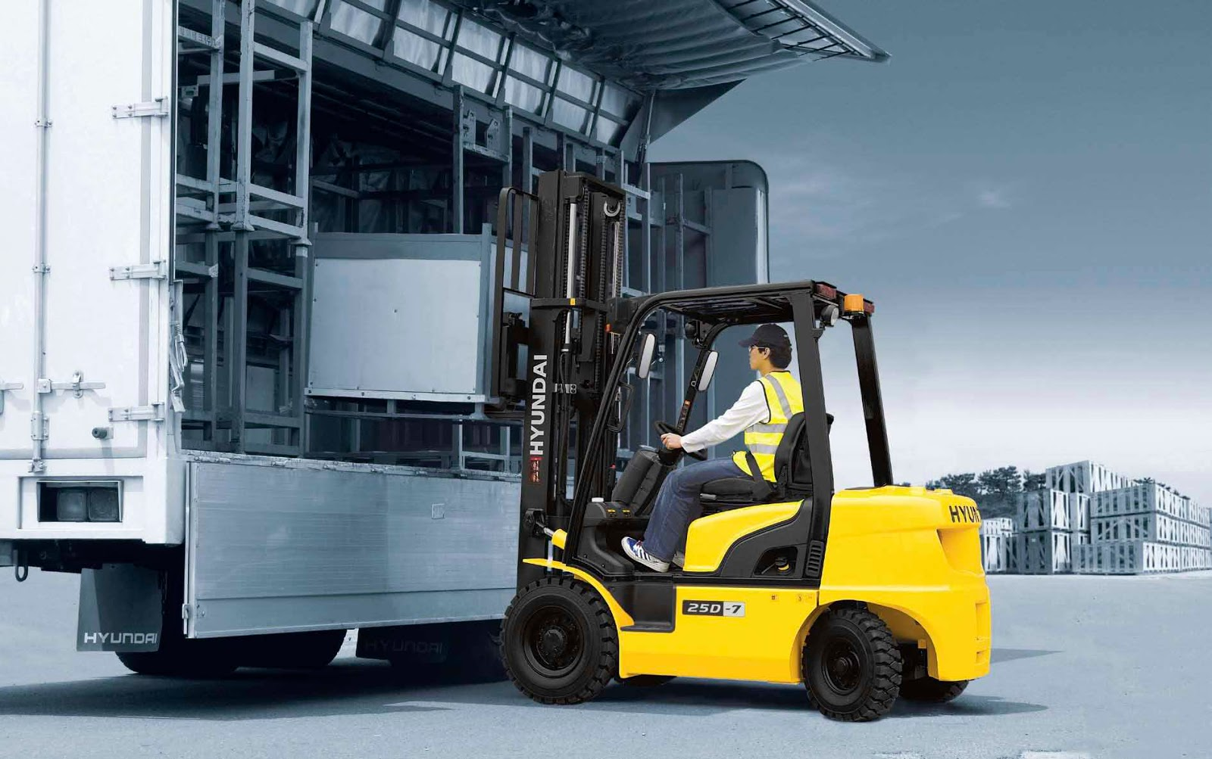
Kits are based of service intervals in the Operators Manual.
Each kit comes with everything needed to perform the service.
Kits that end with “W” are wet kits and include all filters and fluids.
If bulk kits are needed please contact your CSR to have kits built and shipped.

Slide 3
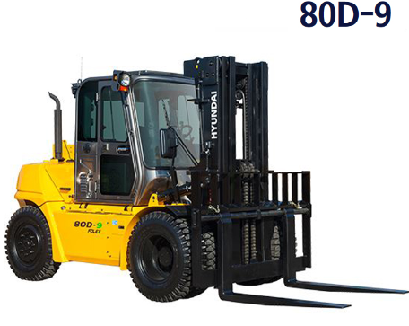
1000 Hour Kit
Kit Part Number: 50-80D9-1000
Kit Components
Description | Part Number | QTY
Engine oil filter | 1DFQ-60301 | 1
Pre-filter-fuel | 11KA-71040 | 1
Fuel filter-engine | 1DFQ-60200 | 1
O-Ring, Fuel filter | YUBP-05625 | 1
Hydraulic Oil Tank Air Breather | 31EE-02110-A | 1
Element Outer, Air Cleaner | 1DFQ-20120 | 1
Element Inner, Air Cleaner | 1DFQ-20130 | 1
Transmission Oil Filter | ZGAQ-02400 | 1
Transmission Drain Plug O-Ring | ZGAQ-01760 | 1
Transmission Air Breather | ZGAQ-00258 | 1
Axle Air Breather | HF50-10140 | 1
Axle Drain Plug O-Ring | S612-030001 | 2
Pilot Line filter element | 31E3-0018-A | 1
O-Ring, Pilot Line filter | 31E3-00700 | 1
Filter, Aircon- External | 1EFQ-90441 | 1
Filter, Aircon- Cabin | XKBU-00201 | 1
Belt, Fan | YUBP-10729 | 1
Hydraulic oil return filter | 904738400-A | 1
Gasket, Hydraulic oil tank | 31FQ-30020 | 1
Hydraulic Tank Drain Plug O-Ring | S631-014004 | 1
500 Hour Kit
Kit Part Number: 50-80D9-0500W
Kit Components
Description | Part Number | QTY
Air breather element | 31EE-02110-A | 1
Pre-filter-fuel | 11KA-71040 | 1
Fuel filter-engine | 1DFQ-60200 | 1
O-Ring, Fuel filter | YUBP-05625 | 1
Engine oil filter | 1DFQ-60301 | 1
Xteer HD9000 15W40 | KDHO-00035 | 4

Slide 4
Logistics Lift Models – 30/110

Slide 5
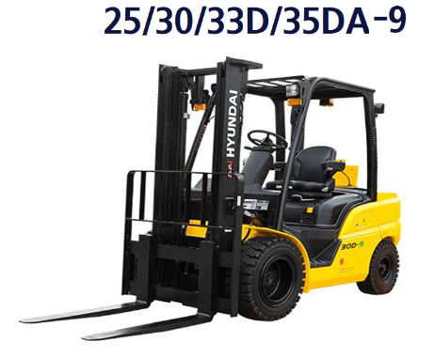
500 Hour Kit
Kit Part Number: 2233D35DA9-0500
Kit Components
Description | Part Number | QTY
Pre-filter-fuel | XJBT-03088 | 1
Fuel filter | XJBT-02391 | 1
Engine oil filter | XJBR-00039 | 1
Hydraulic Tank Breatther Filter | 31EE-02110-A | 1
250 Hour Kit (Harsh Conditions)
Order PN 31EE-02110-A
Kit Components
Description | Part Number | QTY
Hydraulic Tank Breatther Filter | 31EE-02110-A | 1

Slide 6
2000 Hour Kit
Kit Part Number: 2233D35DA9-2000
Kit Components
Description | Part Number | QTY
Engine oil filter | XJBR-00039 | 1
Oil Separator Filter Element | XJBT-03224 | 1
Fuel filter | XJBT-02391 | 1
Pre-filter-fuel | XJBT-03088 | 1
Transmission Oil Filter | XKCF-01290 | 1
Transmission Air Breather | XKCF-01015 | 1
Axle Air Breather | XKCF-00502 | 1
Element - Hyd. Oil Breather | 31EE-02110-A | 1
Hydraulic Oil Suction Filter | J05071404 | 1
Hydrualic Oil Tank Gasket | 33HM-30100 | 1
Hydraulic Oil Tank O-Rings | S631-014004 | 3
Hydraulic Tank Drain O-Ring | S631-014004 | 1
Belt, Fan | XJBT-03168 | 1
Outer Air Cleaner Element | 11HA-20220 | 1
Inner Air Cleaner Element | 11HA-20230 | 1
1000 Hour Kit
Kit Part Number: 2233D35DA9-1000
Kit Components
Description | Part Number | QTY
Engine oil filter | XJBR-00039 | 1
Fuel filter | XJBT-02391 | 1
Pre-filter-fuel | XJBT-03088 | 1
Transmission Oil Filter | XKCF-01290 | 1
Transmission Air Breather | XKCF-01015 | 1
Axle Air Breather | XKCF-00502 | 1
Element - Hyd. Oil Breather | 31EE-02110-A | 1
Hydraulic Oil Suction Filter | J05071404 | 1
Hydrualic Oil Tank Gasket | 33HM-30100 | 1
Hydraulic Oil Tank O-Rings | S631-014004 | 3
Hydraulic Tank Drain O-Ring | S631-014004 | 1
Belt, Fan | XJBT-03168 | 1

Slide 7
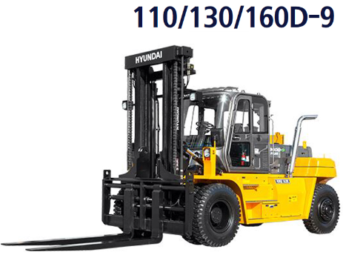
500 Hour Kit
Kit Part Number: 110-160D9-0500
Kit Components
Description | Part Number | QTY
Engine oil filter | 11N8-70110 | 1
Pre-filter-fuel | 11KA-71040 | 1
Fuel filter-engine | 11Q7-71010 | 1
Hydraulic Tank Air Breather | XKDP-00001 | 1
500 Hour Kit
Kit Part Number: 110-160D9-0500W
Kit Components
Description | Part Number | QTY
Pre-filter-fuel | 11KA-71040 | 1
Fuel filter-engine | 11Q7-71010 | 1
Engine oil filter | 11N8-70110 | 1
Xteer HD Ultra 15W40 | KDHO-00035 | 4

Slide 8
1000 Hour Kit
Kit Part Number: 110-160D9-1000 (Serial Number Break 110D-9 -00242; 130D-9 -00120; 160D-9 -00451)
Kit Components
Description | Part Number | QTY
Engine oil filter | 11N8-70110 | 1
Pre-filter-fuel | 11KA-71040 | 1
Fuel filter-engine | 11Q7-71010 | 1
Hydraulic Tank Air Breather | XKDP-00001 | 1
Element Outer, Air Cleaner | 11LL-45181 | 1
Element Inner, Air Cleaner | 11LL-45190 | 1
Transmission Oil Filter | ZGAQ-02400 | 1
Breather, DIC Axle | XKBT-00802 | 1
Breather, KESSLER Axle | ZGBJ-00002 | 1
Hub Drain Plug O-Ring (DIC) | XKBT-00222 | 2
Hub Drain Plug O-Ring (Kessler) | ZGBJ-00041 | 2
Pilot Line filter element | 31E3-0018-A | 1
O-Ring, Pilot Line filter | 31E3-00700 | 1
Filter, Aircon- External | 71LB-00290-P | 1
Filter, Aircon- Cabin | 11FT-94240 | 1
Belt, Fan | XKDE-02204 | 1
Hydraulic tank oil return filter | 31FT-05063 | 1
Hydraulic oil tank gasket | 31FT-30090 | 1
Hydraulic Oil Tank Drain Plug O-Ring | S611-023001 | 1
1000 Hour Kit
Kit Part Number: 110-160D9-1001 (Serial Number Break 110D-9 00243-; 130D-9 00121-; 160D-9 00452-)
Kit Components
Description | Part Number | QTY
Engine oil filter | 11N8-70110 | 1
Pre-filter-fuel | 11KA-71040 | 1
Fuel filter-engine | 11Q7-71010 | 1
Hydraulic Tank Air Breather | XKDP-00001 | 1
Element Outer, Air Cleaner | 11LL-45181 | 1
Element Inner, Air Cleaner | 11LL-45190 | 1
Transmission Oil Filter | ZGAQ-02400 | 1
Breather, DIC Axle | XKBT-00802 | 1
Breather, KESSLER Axle | ZGBJ-00002 | 1
Hub Drain Plug O-Ring (DIC) | XKBT-00222 | 2
Hub Drain Plug O-Ring (Kessler) | ZGBJ-00041 | 2
Pilot Line filter element | 31E3-0018-A | 1
O-Ring, Pilot Line filter | 31E3-00700 | 1
Filter, Aircon- External | 71LB-00290-P | 1
Filter, Aircon- Cabin | XKBU-01089 | 1
Belt, Fan | XKDE-02204 | 1
Hydraulic tank oil return filter | 31FT-05063 | 1
Hydraulic oil tank gasket | 31FT-30090 | 1
Hydraulic Oil Tank Drain Plug O-Ring | S611-023001 | 1

Slide 9
2000 Hour Kit
Kit Part Number: 110-160D9-2000 (Serial Number Break 110D-9 -00242; 130D-9 -00120; 160D-9 -00451)
Kit Components
Description | Part Number | QTY
Engine oil filter | 11N8-70110 | 1
Pre-filter-fuel | 11KA-71040 | 1
Fuel filter-engine | 11Q7-71010 | 1
Hydraulic Tank Air Breather | XKDP-00001 | 1
Element Outer, Air Cleaner | 11LL-45181 | 1
Element Inner, Air Cleaner | 11LL-45190 | 1
Transmission Oil Filter | ZGAQ-02400 | 1
Breather, DIC Axle | XKBT-00802 | 1
Breather, KESSLER Axle | ZGBJ-00002 | 1
Hub Drain Plug O-Ring (DIC) | XKBT-00222 | 2
Hub Drain Plug O-Ring (Kessler) | ZGBJ-00041 | 2
Pilot Line filter element | 31E3-0018-A | 1
O-Ring, Pilot Line filter | 31E3-00700 | 1
Filter, Aircon- External | 71LB-00290-P | 1
Filter, Aircon- Cabin | 11FT-94240 | 1
Belt, Fan | XKDE-02204 | 1
Gasket, Hydraulic oil tank | 31FT-30090 | 1
Crankcase Brether Element | XKBC-00103 | 1
Crankcase Breather Element Gasket | YUBP-09446 | 1
Hydraulic tank oil return filter | 31FT-05063 | 1
Hydraulic oil tank gasket | 31FT-30090 | 1
Hydraulic Oil Tank Drain Plug O-Ring | S611-023001 | 1
2000 Hour Kit
Kit Part Number: 110-160D9-2001 (Serial Number Break 110D-9 00243-; 130D-9 00121-; 160D-9 00452-)
Kit Components
Description | Part Number | QTY
Engine oil filter | 11N8-70110 | 1
Pre-filter-fuel | 11KA-71040 | 1
Fuel filter-engine | 11Q7-71010 | 1
Hydraulic Tank Air Breather | XKDP-00001 | 1
Element Outer, Air Cleaner | 11LL-45181 | 1
Element Inner, Air Cleaner | 11LL-45190 | 1
Transmission Oil Filter | ZGAQ-02400 | 1
Breather, DIC Axle | XKBT-00802 | 1
Breather, KESSLER Axle | ZGBJ-00002 | 1
Hub Drain Plug O-Ring (DIC) | XKBT-00222 | 2
Hub Drain Plug O-Ring (Kessler) | ZGBJ-00041 | 2
Pilot Line filter element | 31E3-0018-A | 1
O-Ring, Pilot Line filter | 31E3-00700 | 1
Filter, Aircon- External | 71LB-00290-P | 1
Filter, Aircon- Cabin | XKBU-01089 | 1
Belt, Fan | XKDE-02204 | 1
Hydraulic oil return filter | 31FT-05063 | 1
Crankcase Brether Element | XKBC-00103 | 1
Crankcase Breather Element Gasket | YUBP-09446 | 1
Hydraulic tank oil return filter | 31FT-05063 | 1
Hydraulic oil tank gasket | 31FT-30090 | 1
Hydraulic Oil Tank Drain Plug O-Ring | S611-023001 | 1

