Slide 1
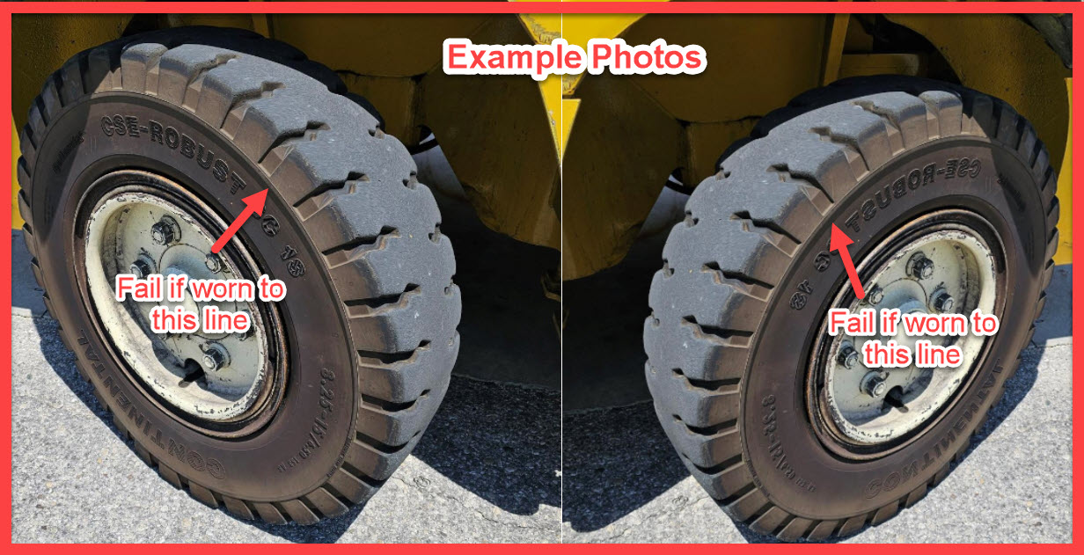
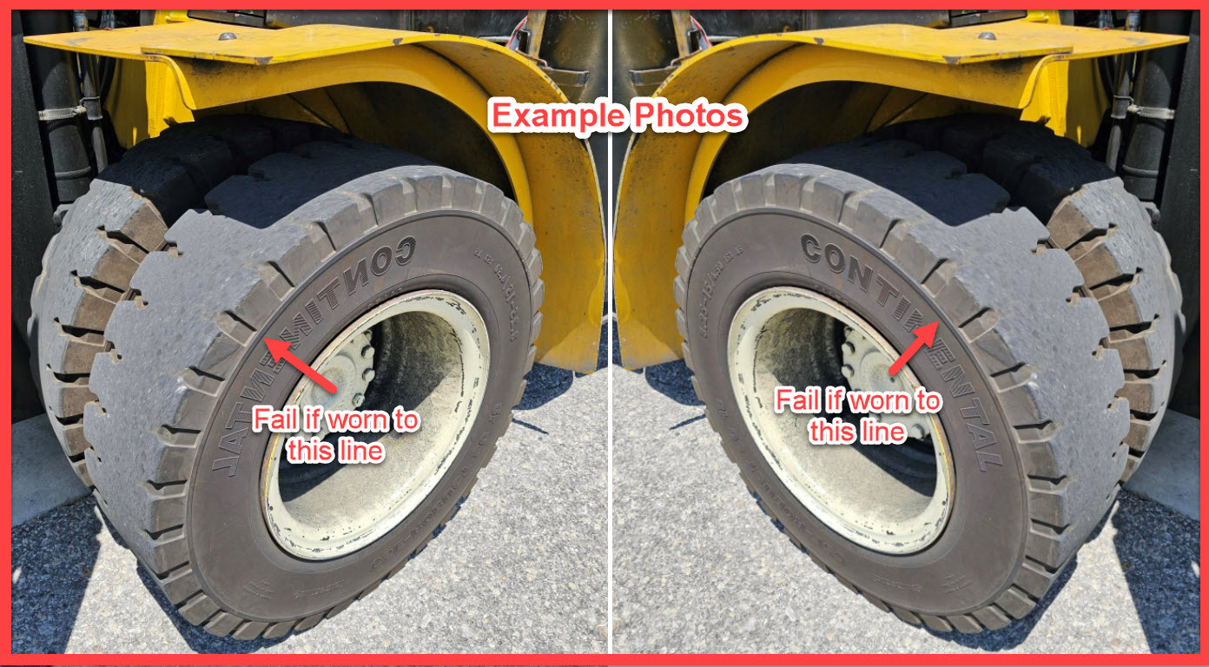
Forklift Tire Order Process Updated 7/23/25
STEP 1 – Proper inspections of the tires are required. Solid tires do not need to be replaced until they are within a half inch of the wear line.
(See Examples for drive/steer tires)

Slide 2
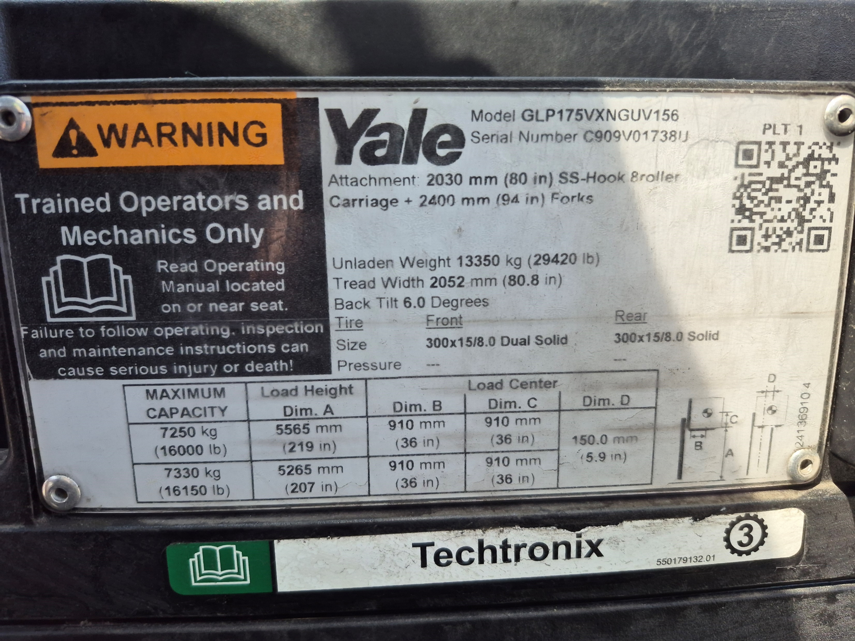

Forklift Tire Order Process Updated 7/23/25
Step 2 – Email Brannon Hufstetler a picture of the data plate showing the tire size and Storage Center address.
You will be copied on the quote and approval email chain.
Caution
Do not order tires through your forklift Vendor, we have a National Account with Continental Tire and they will handle installation and disposals of the old tires.

Slide 3
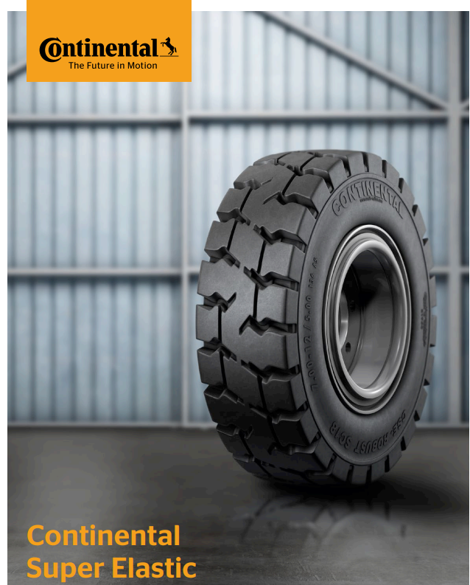
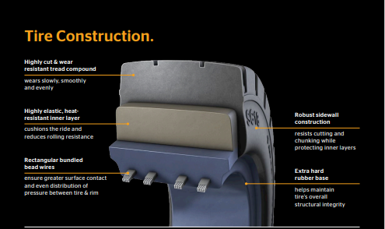
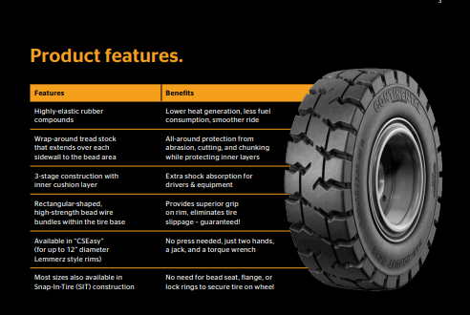
Appendix Updated 7/23/25

