Slide 1



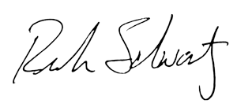
APRIL 2025
20 Years of Service
First Lastname
With sincere appreciation for your dedication and the positive impact you’ve made at PODS.
Rich Schwartz
SVP, Corporate Operations
Patrick Gilmore
Sr. Territory Manager – Northern CA

