Slide 1
Driver Hotline Details and
Warehouse Return Not Locked Properly
Kenneth McKellar, Mgr II – Ops Support, SSC
Alejandro Velarde, Mgr I – CI Optimization, Corp Ops
Sam Fresquez, Pathfinders – Continuous Improvement, Corp Ops

Slide 2

Agenda
Availability
Driver Hotline Process
Ops Support Responsibilities

Slide 3



Availability
When/why should I call the hotline?
  When encountering issues that will prevent the driver from completing the job and, in collaboration with their MM, it is determined that the job will need to be rescheduled.
Monday–Saturday: 7:30 a.m. – 10:00 p.m. EST
Closed on Sundays
Any inquiries made through the hotline will receive expedited attention.
By adhering to this process, drivers and support teams can ensure efficient resolution of rescheduling needs while minimizing unnecessary changes and maintaining customer satisfaction.

Slide 4
Driver Hotline Process
Step 1: Notify Market Manager
  Attempt a Phone Call: The driver should call the Market Manager before proceeding to the next job.
  Market Manager Response:
  If the Market Manager answers, they will provide instructions:
    Call the Driver Hotline or
    Offer an alternative solution.
  If the Market Manager does not answer, proceed to Step 2.

Slide 5
Driver Hotline Process
Step 2: Evaluate Rescheduling Needs
  Blocked Placement Area or Customer-Resolved Issues:
  If the issue is due to a blocked placement area or any other issue that might be resolved by speaking with the customer:
    The driver must wait 15 minutes to allow time for resolution.
    During this time, the driver will make every effort to communicate with the Manager if they are not able to make contact on the initial call in step one.

Slide 6
Driver Hotline Process
Step 3: If Unable to Contact Market Manager, Call Ops Support at 855-640-4853
  Driver Preparation: Before calling Ops Support , ensure you have:
  Order Number
  Service Date
  Reason for Reschedule or Service Modification Details.
  New Service Date based on Reschedule Guidelines below.
  Reschedule Guidelines:
  If the reschedule is due to a PODS issue (e.g., equipment or hours of service constraints), the customer should be rescheduled for the following day.
  If the reschedule is at the customer's request or due to a placement issue that cannot be resolved within the 15-minute wait period, the customer can be rescheduled to the next available day.

Slide 7
Ops Support Responsibilities
Case Creation and Customer Notification
  Ops Support will create the appropriate Salesforce case.
  Ops Support will notify customers as needed.
Limitations by Order Type
  Commercial Orders: Ops Support cannot make changes that affect pricing.
  Canadian Orders: Ops Support can only modify dates (no address or service type changes).
  Hawaii/City Service Jobs: Ops Support cannot make any updates.
Priority Handling
  Any request made via the Driver Hotline is treated as a priority and will be addressed immediately after the call.
  Requests are expected to be completed within one hour during operational hours.

Slide 8
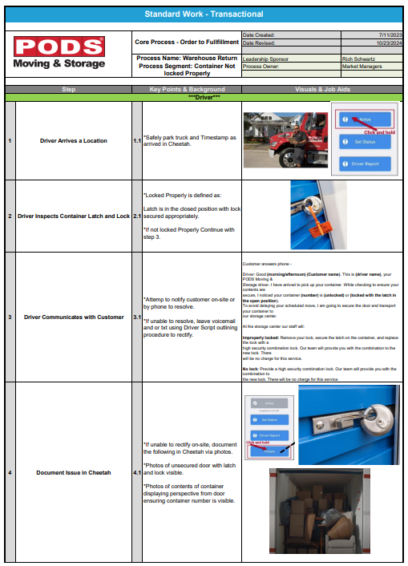
Warehouse Return Not Locked Properly
Purpose
Eliminate same-day reschedules due to containers not being properly secured with a lock
Provide customers a level of service that:
    Will not impede or delay downstream services
    Secures container contents
Increased on-time delivery
    Fewer route disruptions
    Improve route efficiency
Remind drivers of the importance of following the process
Policy

Slide 9
Warehouse Return Not Locked Properly
Changes
Outlined steps and links to create the correct Salesforce case, ensuring proper communication to Ops Support and customer
SSC communications setting proper expectations with customers
Set random combination for lock, ensuring the safety of customers’ contents and limiting access

Slide 11
Thank You

