Slide 1
Corp Ops POET Overview
December 2024

Slide 2
Today’s Discussion
Purpose:
Provide a closer look to Corp Ops users on the new Salesforce CPQ tool that will replace OE
Demonstrate new features SSC agents will have that should improve order quality and the Corp Ops users experience
Demonstrate new features Corp Ops users will have to improve market and location management
Agenda:
Provide an overview of Today in OE vs. Tomorrow in Salesforce specific to Corp Ops users
Demo Actions Corp Ops Users Will Perform in Salesforce
  Understand How New Salesforce Features Tie in with Case Management
  Search for an Account & Navigate the Account Page
  Search for an Order
  Review Order Details
  Search for a Market Page, Navigate to a Storage Center Page, Update a Zip Code Regulation

Slide 3
Today (OE) vs. Tomorrow (Salesforce CPQ)
What it NOT changing as part of the POET go-live
Case Management
While CPQ is also part of the salesforce platform, there will be no changes to the current case management processes or reporting. Cases will remain the primary way of collaborating between functional teams to address customer and order matters.
Adding Ancillary Items via Mercurygate Handheld Device
Drivers will continue to be able to add ancillary items as they do today. Ancillary items will sync back to the customer order.
RBMS / Cheetah User Interfaces
While there is work to redirect and enhance integrations from these systems to salesforce CPQ, there will not be changes to the RBMS or Cheetah interfaces as part of POET go-live. Timestamping, routing will continue in these applications.

Slide 4
Today (OE) vs. Tomorrow (Salesforce CPQ)
CPQ will introduce new capabilities to benefit Corp Ops, but the way the team engages with CPQ is expected to be different from how we engage with OE today
 | Today (OE) | Tomorrow (Jan 2025 Salesforce CPQ)
Permissions | Search / View accounts and orders Modify orders including reschedules, add ancillary items, add fees | Search / View accounts and orders Edit Drivers Notes for an order All other order modifications should be routed through Ops Support
Regulations and Script Screens | Markets update regulations in RBMS Coordinate updates to script screens through Ops Support | All regulations and script screen info is maintained in salesforce (Corp Ops and Ops Support have ability to edit) – Once POET is live

Slide 5
New features for SSC users that will improve quality of orders passed down to Corp Ops
CPQ Enhancements
Benefits to Corp Ops
1
SSC agents will have increased visibility to the availability calendar
Visibility to exact job limits will improve ability for SSC to recommend alternative dates or minimize calendar overrides
2
SSC agent can flag when a customer is flexible with their service dates
Corp Ops/Ops Support can prioritize these customers in the event of schedule disruptions or mass re-schedules
3
SSC agent can only quote/order ancillary items that are set to “on” for the origin market. Items must be affiliated with the initial delivery of a container
Confirms sales process aligns to items within the market and orders link ancillary items to container delivery services
4
Placement and permit regulations require agent acknowledgement on the same screen as driver notes
Heightens SSC agent accountability to review and explain guidelines to customer during order booking
5
System automatically identifies forms and fees required for an order (non-paved surface waiver/fee)
Informs customer of non-paved surface waiver and fee up front to avoid disputes; prevents reschedules due to incomplete forms

Slide 6
New features were also developed to specifically serve Corp Ops users
CPQ Enhancements
Benefits to Corp Ops
1
Salesforce will reverify serviceability and availability at time of booking (OE only verifies when quoting)
Prevents influx of orders where serviceability or availability conditions have changed since quoting
2
SSC agent requests to override the calendar will be submitted, approved, tracked, and reported in CPQ
Heightened SSC accountability to adhere to policies around calendar overrides and facilitates more direct coaching when breached
3
Driver comments captured during a service are now visible to agents. Driver notes no longer include excess detail on premium services, ancillary items, etc.
Comments left by drivers will sync back to salesforce for agents to see on future services. Premium services, ancillary items will be “added to the cart” for the order to avoid redundant info
4
PODS driven changes will not be given a price to limit back-end adjustments (e.g., warehouse moves)
Ability to request warehouse moves to achieve operational efficiencies without causing a customer price impact
5
Hawaii orders will be handled on a single order, no longer requires a Long Distance and Local order
Improved visibility and traceability to order history by managing all services from a single order

Slide 7
Visualizing the Top 5 Salesforce Features for Corp Ops Users
October 2024

Slide 8
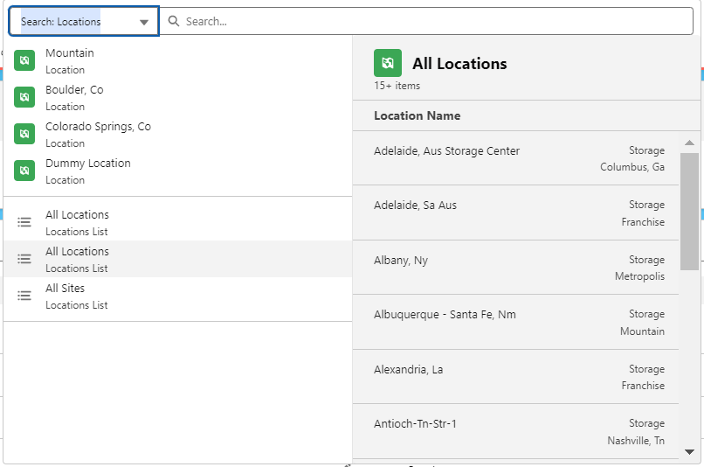
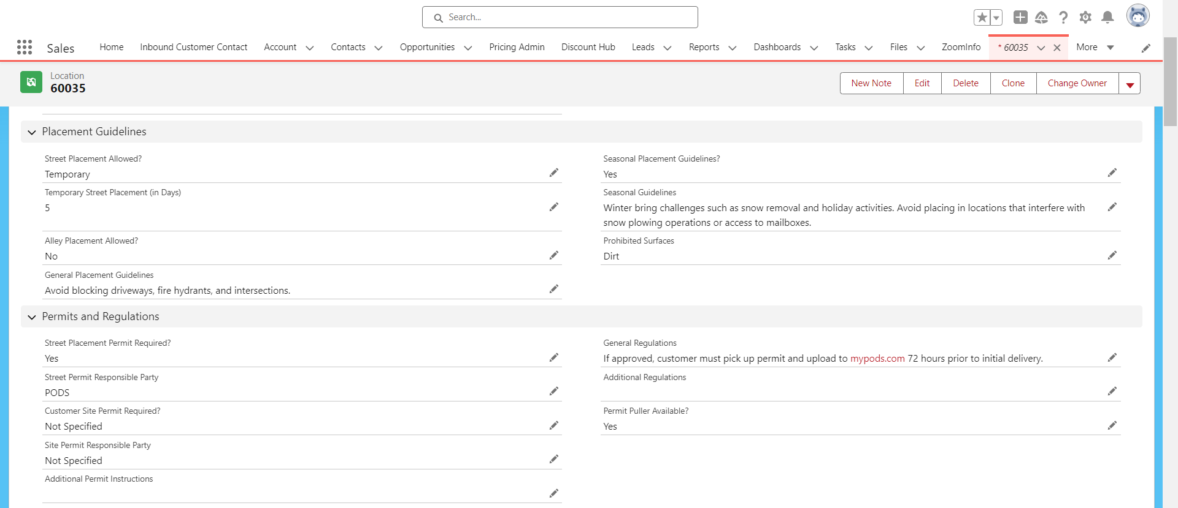
1. Location and Regulation Management - Easy search and maintenance of location information and zip code regulations
Use the global search bar to search for a market, storage center, or zip code. Identify key contacts, location details, and placement or permit regulations related to placement guidelines and permit requirements.
Moving from the free text fields of RBMS to structured data fields introduces more consistency to how regulations are documented across markets.
This information can be updated by Corp Ops or ops support team members.

Slide 9
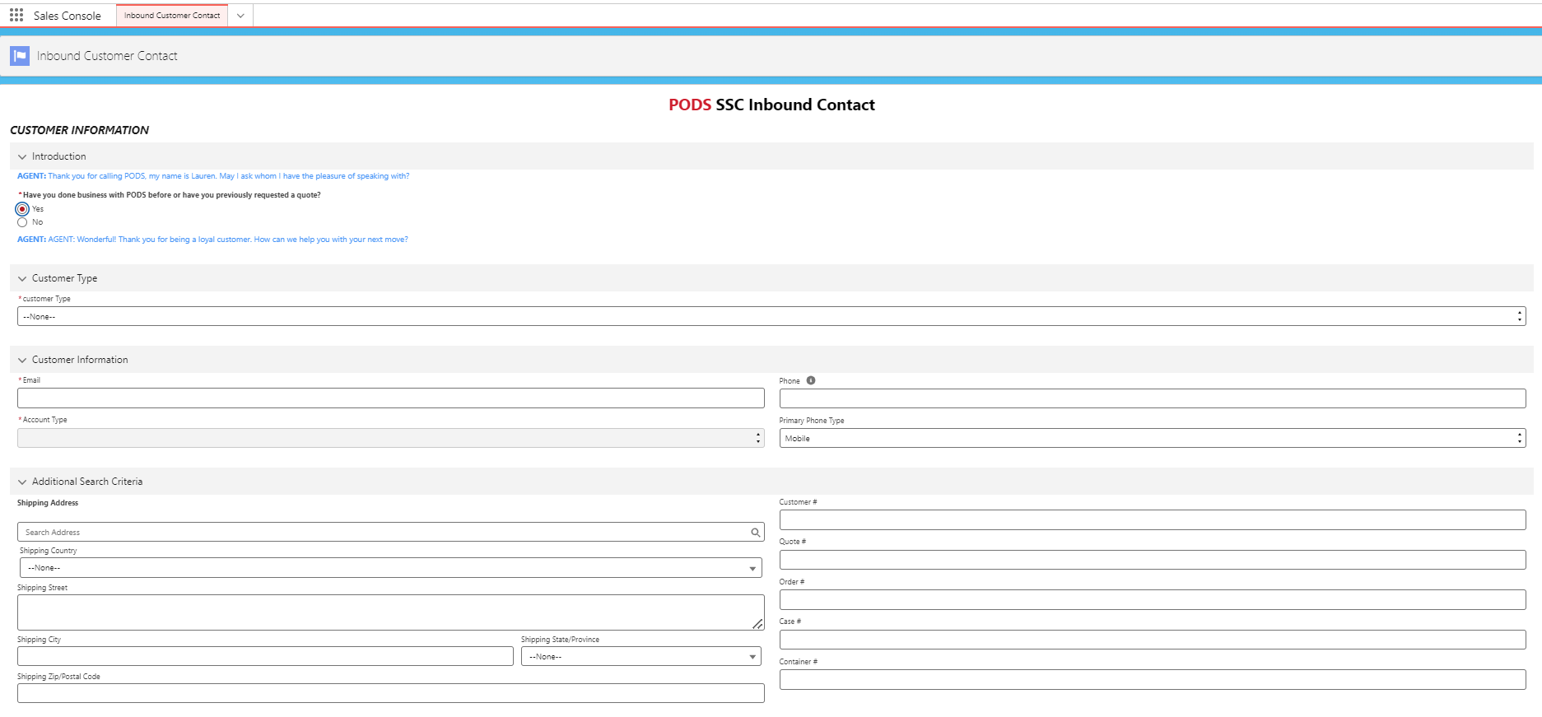
2. Customer Account and Order Search – Expanded search capabilities to quickly identify the right customer account and order
Search for a customer account or order by an expanded set of factors:
Customer email
Customer phone number
Order number
Case number
Container number

Slide 10
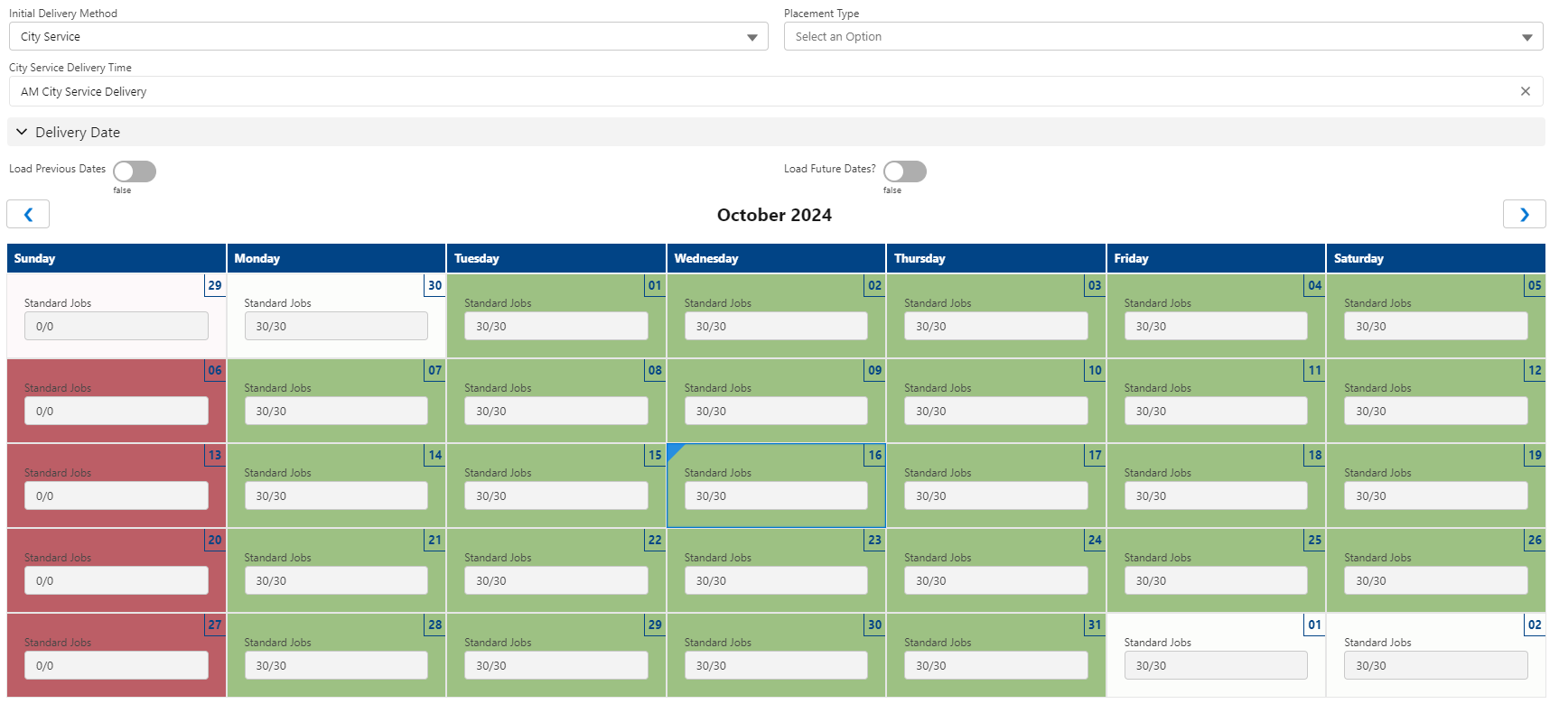

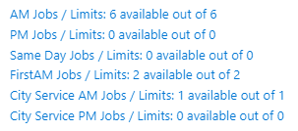
3. Availability Calendar - improved agent visibility to exact job counts to simplify regulations and empower agents to recommend alternative dates before requesting a calendar override
The Availability Calendar that SSC agents will use is fed by the following live data inputs from RBMS:
Container Availability
Available Standard job slots remaining (always shown in each calendar box)
Available Premium Service job slots remaining (if applicable)
Available City Service job slots remaining (if applicable)
This eliminates the need for Corp Ops to include this detail in regulations or script screens
The calendar will allow agents to…
Identify alternative dates BEFORE requesting an override
Up-sell and recommend premium services with confidence
Elicit urgency to book when availability is running low

Slide 11
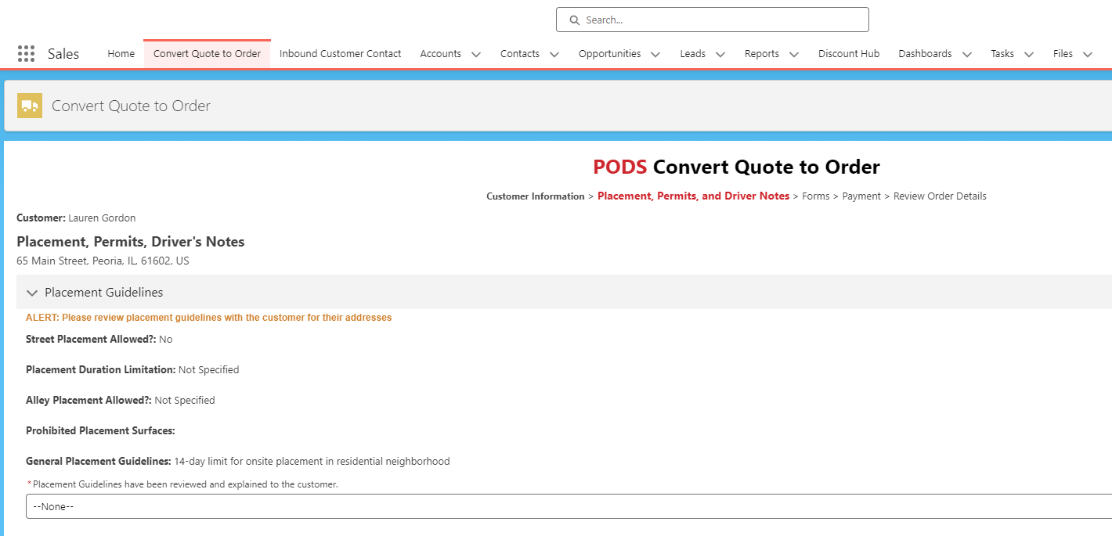
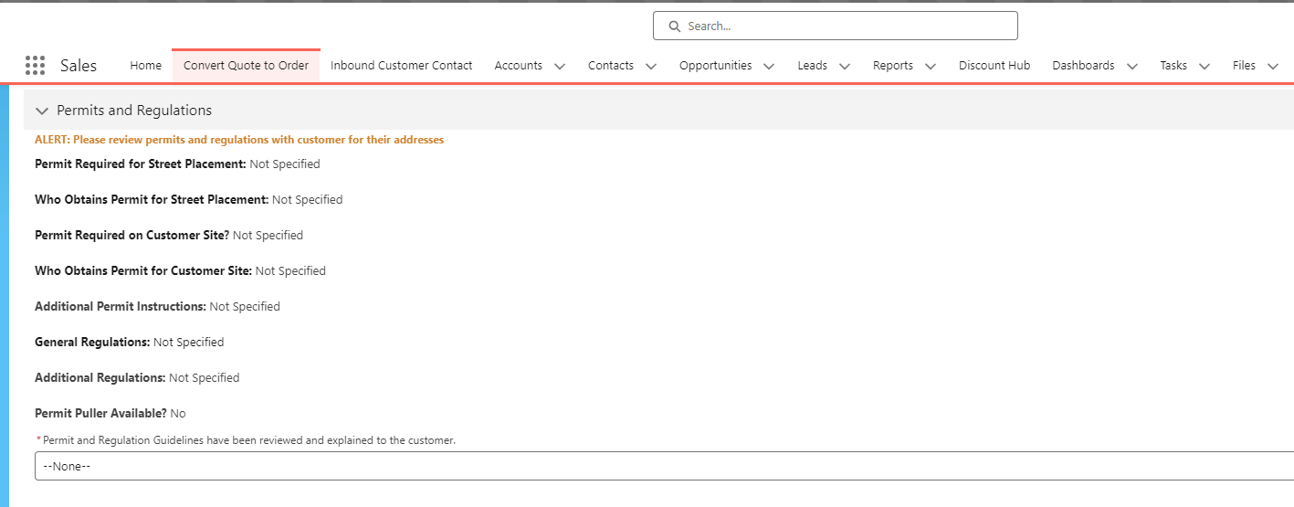
4. Placement and Permit Regulations Display - Improved data structure for SSC agents to clearly communicate placement guidelines and regulations
Agents will review placement / permit requirements and be required to acknowledge information was explained to the customer.
Information appears on the same page where they populate drivers notes for easy reference

Slide 12
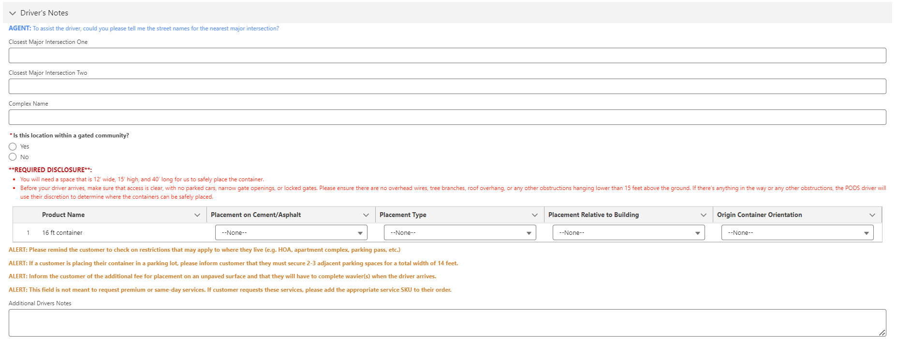
5. Auto-Apply Non-Paved Surface Waiver and Fee - Improved data structure for SSC agents to clearly communicate placement guidelines and regulations
System will auto-apply non-paved surface fee and require waiver when selecting “no” to placement on cement or asphalt
Agents will see related disclosures and alerts to remind them to:
Alert customer to confirm plans with local HOA
Share space / clearance required
Explain parking lot space requirements
Not include premium services in notes

Slide 13
POET | Salesforce Cases for Corp Ops
Goal:
All Market Managers and AMMs submit at least one accurate Salesforce case by 12/31/2024.
Support:
A short (5-8 min) eLearning with video demonstration and step-by-step job aid download.
Reporting:
Scorecard: Tracks case submissions by Market Managers by Region.

Slide 14
