Slide 1
DRIVE MOTOR MAINTENANCE
PODS HYDRAULIC SYSTEM 1ST GENERATION PODZILLA

Slide 2
TRAINING AGENDA
DRIVE MOTOR ASSEMBLY
GENERAL MAINTENANCE
TROUBLESHOOTING

Slide 3

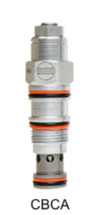
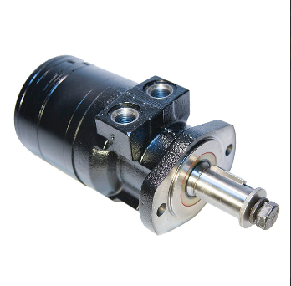
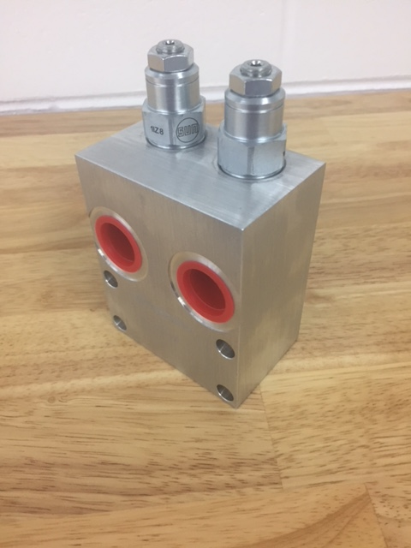
What makes up the drive motor assembly?
COUNTERBALANCE VALVES
CBCALJN / YTA Manifold
Parker Medium Duty
Hydraulic Motor
TG series
Animatronics

Slide 4
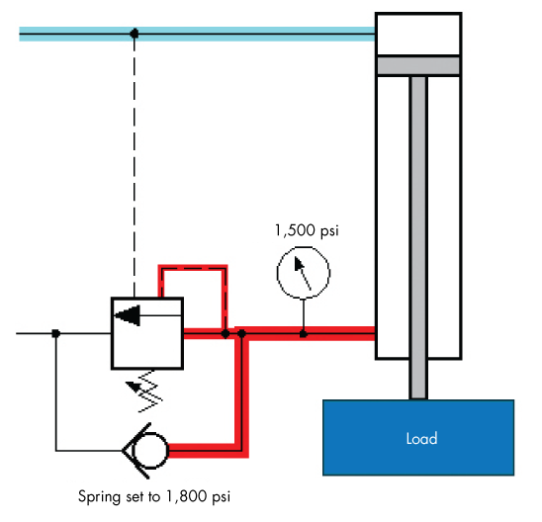
Drive Motor Counterbalance Valve
CBCALJN
Counterbalance Valve Features
Standard Set Screw Adjustment
Pressure Setting 3000 psi
25 psi check setting
Counterbalance valves should be set at least 1.3 times the maximum load induced pressure.
Turn adjustment clockwise to decrease setting and release load.
Full clockwise setting is less than 200 psi (14 bar).
Backpressure at port 2 adds to the effective relief setting at a ratio of 1 plus the pilot ratio times the backpressure.

Slide 5
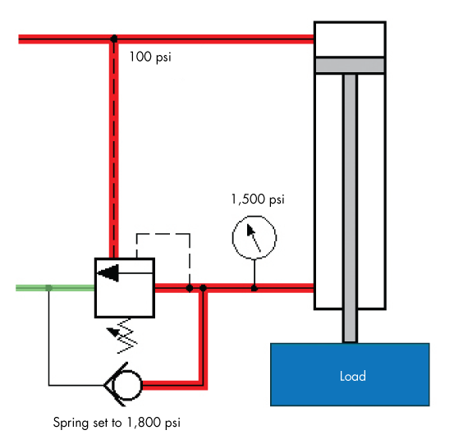
Counterbalance Valves
Reseat exceeds 85% of set pressure when the valve is standard set. Settings lower than the standard set pressure may result in lower reseat percentages.
These counterbalance cartridges are installed directly into a cavity mounted to the motor for added protection and improved stiffness in the circuit.

Slide 6
Counterbalance Valves Adjustment Procedure
Counterbalance valves should always be pressure set prior to their installation into the system.

Slide 7
Counterbalance Valves Adjustment Procedure
Observe the gauge and record the maximum pressure generated when raising the load.
Using the Sun Counterbalance Valve Pressure Setting vs. Turns table, verify the amount of psi is 1760 PSI per turn.
Multiply the observed load pressure by 1.3 and readjust the counterbalance valve to the calculated pressure by either increasing (turning counterclockwise) or decreasing (turning clockwise) to vary the setting.
Note: You will not be able to observe the final setting of the valve on the gauge, as this setting will be higher than the highest load induced pressure.

Slide 8
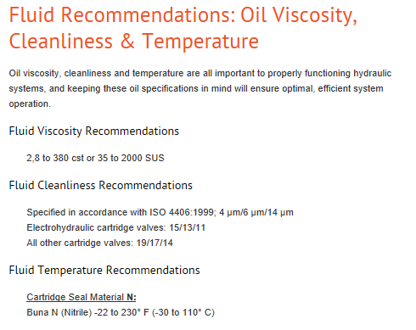
Counterbalance Valves Maintenance
Troubleshooting
The most common failure of a cartridge valve is contamination in the hydraulic fluid.
Contaminants lodge in the working parts of the cartridge and interfere in the operation.

Slide 9
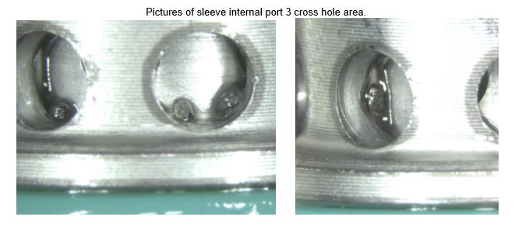
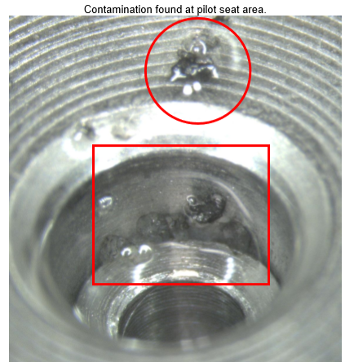
Counterbalance Valves Contamination

Slide 10
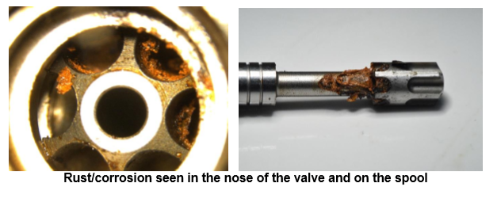
Counterbalance Valves Contamination

Slide 11
Counterbalance Valves Maintenance
How to Clean the Sun Counterbalance Valves
Carefully de-pressurize the hydraulic system.
Remove the cartridge from its cavity
Inspect the valve for visible contaminants and if found remove.
Submerge in clean mineral spirits
Manually operate the inner working parts.
All parts should move freely
After flushing, blow dry the cartridge with clean, filtered air.
Replace any seals that are worn using a Sun seal kit.
Dip the cartridge in clean hydraulic fluid .
Reinstall the cartridge and tighten and retest.
If this does not work, replace the valve with a new one.

Slide 12
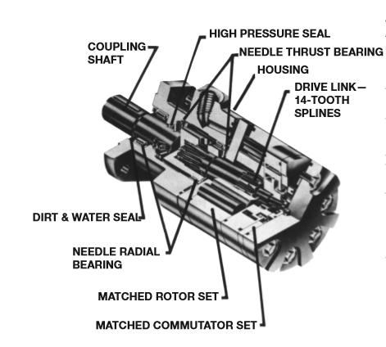
Parker Hydraulic Motor
Parker TG series Medium Duty Motor
Counterbalance Valve Features :
Unique High Pressure Seals the eliminate the need for a case drain and check valve
Thrust capacity 1000 lbs in either direction
Arrangement of internal splines transmit more torque and allow for superior lubrication resulting in less spline wear.
Zero leak commutator valve set

Slide 13
Parker Drive Motor Preliminary Check
First check for non-hydraulic problems:
Parts damaged from an impact that were not properly repaired or replaced
Improper replacement parts used in previous servicing
Mechanical linkage problems such as binding, broken or lose chain or belts.

Slide 14
Parker Drive Motor Preliminary Check
Check Hydraulic Components for problems
Check Hoses for cracks, hardening, kinks
Replace any hoses
Look for issues with the couplings and fittings
Check the filter and fluid level of reservoir
Look for air bubbles in the reservoir
Check temperature of hydraulic system. It should not be over 200◦F

Slide 15
Parker Drive Motor Troubleshooting
TROUBLE | CAUSE | REMEDY
Oil Leak | Hose Fittings loose , worn, damaged | Check & replace fittings and o-rings
 | Oil Seal rings deteriorated | Replace Motor
 | Bolts are loose or sealing area is deteriorated | Replace the bolt and tighten to torque spec 55 ft-lbs
 | Internal shaft seal is worn or damaged | Replace Motor
 | Worn Coupling shaft | Replace Motor

Slide 16
Parker Drive Motor Troubleshooting
TROUBLE | CAUSE | REMEDY
Significant loss of speed under load | Lack of sufficient oil supply | Check for faulty relief valve and adjust
 |  | Check for faulty pump
 | Excessive Heat | Check oil for temperature. Correct any restrictions in the system
 | High internal Motor leakage | Replace Motor
 | Severely worn or damaged splines | Replace Motor

Slide 17
Parker Drive Motor Troubleshooting
TROUBLE | CAUSE | REMEDY
Low Mechanical Efficiency or undue high pressure required to operate the motor | Line blockage | Locate blockage source and repair or replace it
 | Internal interference in motor | Replace Motor
 | Lack of pumping pressure | Check for worn pump / low relief valve setting
 | Excessive binding or loading in system external to motor. | Locate and eliminate source.

